Slide 1
Fanwort
(Cabomba caroliniana)
Origin: SE USA
Intro to US: Native
Intro to NYS: 1920s (MA)
Plant Type: Submerged
Leaf Type:
Submersed: Pinnate
Floating: Small Flower
Leaf Arrangement: Opposite
Leaf Shape: Thread
Leaf Margin: Smooth

Slide 2
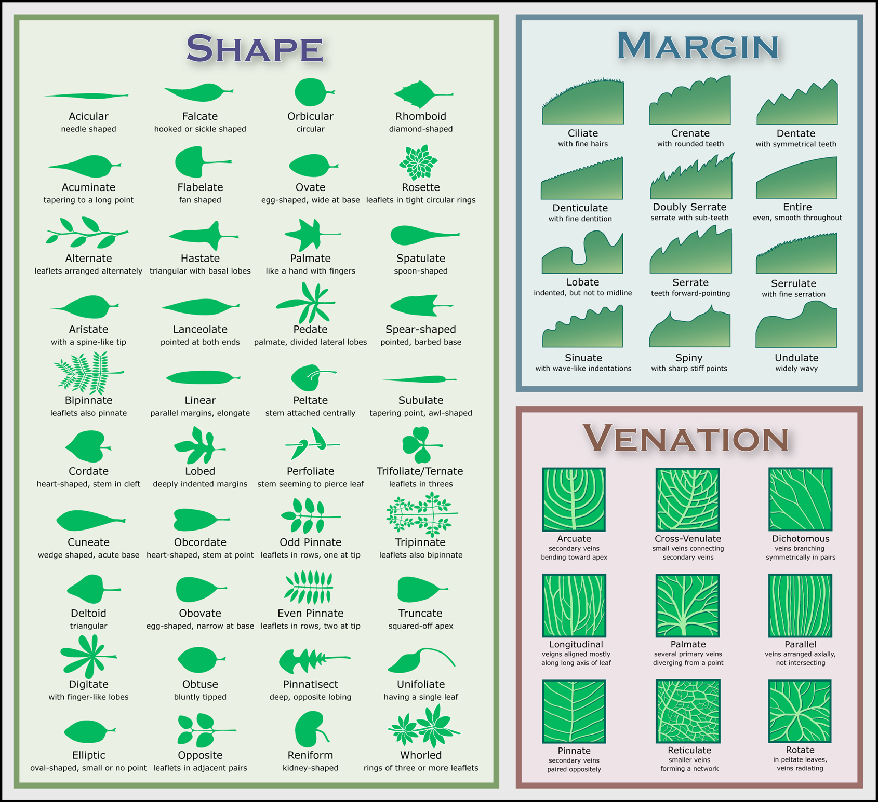
What to know about fanwort (to help find it)
Colors
Green to red to purple
More likely green in deep water
Habitat
Shallow water canopy (Long Island)
Deep meadows (Adirondacks)
Flowers
3 petal- like sepals and 3 petals
White, yellow or pink/purple
Leaves
Submergent- fan shaped, delicate
Floating- small (< ½”), oval(ish)
Margin = smooth
Shaped like letter Y (snakes tongue)
Stems
Reddish-brown hairs
Branched
Turions (overwintering “fruits”)
May be found on green (invasive)
Found at apical tip

Slide 3
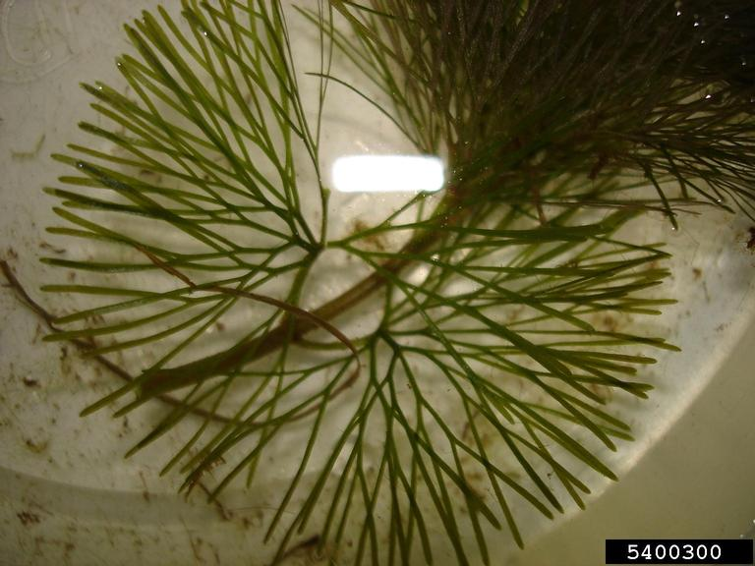
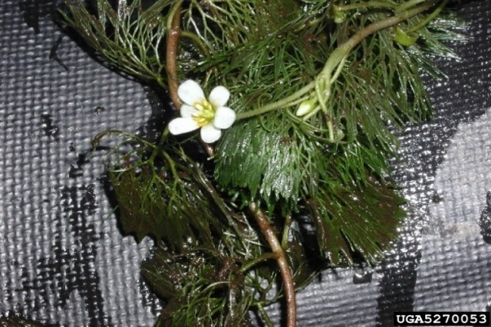
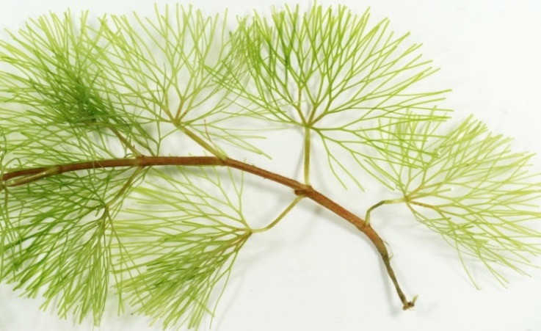
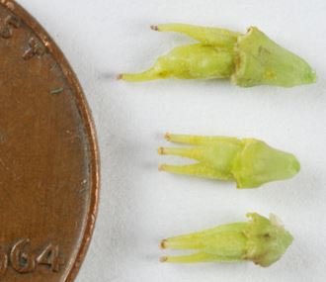
Y shape, fan-like
Petals + sepals
Fruits
Reddish brown hairs, branched stems

Slide 4
Fanwort in Kasoag Lake 2013
(Allied Biological survey)

Slide 5
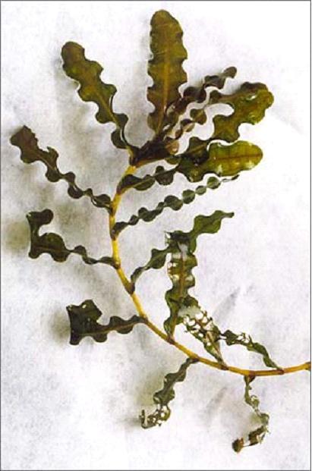
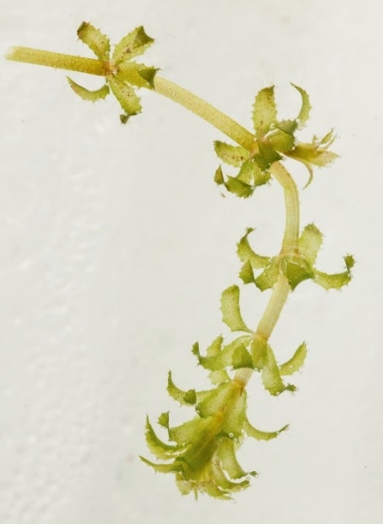
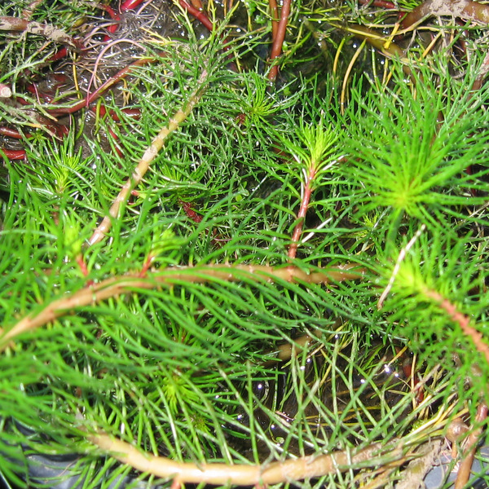
Where to Look: Aquatic Invasive Plant Search
Reference: NYSFOLA plant survey protocol, Janet Andersen
Not the same as a lake-wide plant survey
Look for presence or absence
Not density, distribution, or ecological value
Oriented towards volunteers

Slide 6
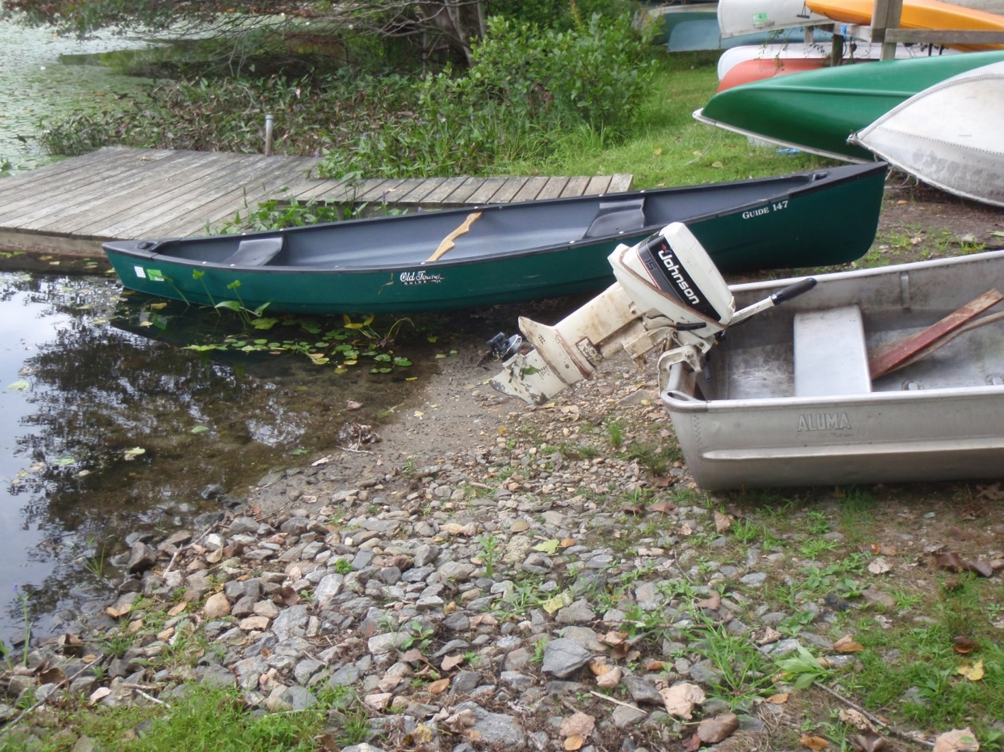
Where to search: boat launches
Notes:
Where to search? Where people are!

Slide 7
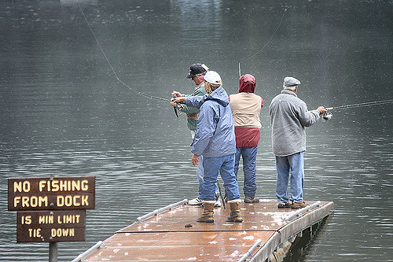
Where to search: public fishing spots
Notes:
Where to search? Where people are

Slide 8
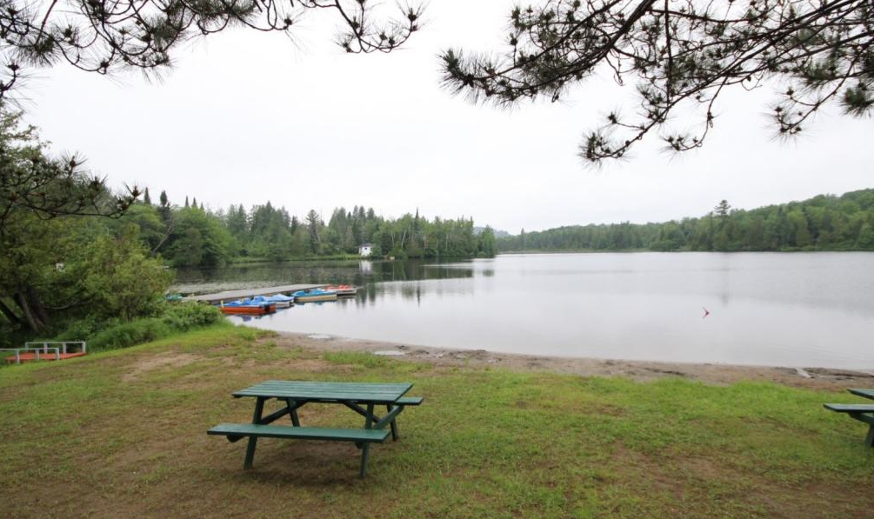
Where to search: public access
(Boating, fishing, or aquarium release)
Notes:
Where to search? Where people are

Slide 9
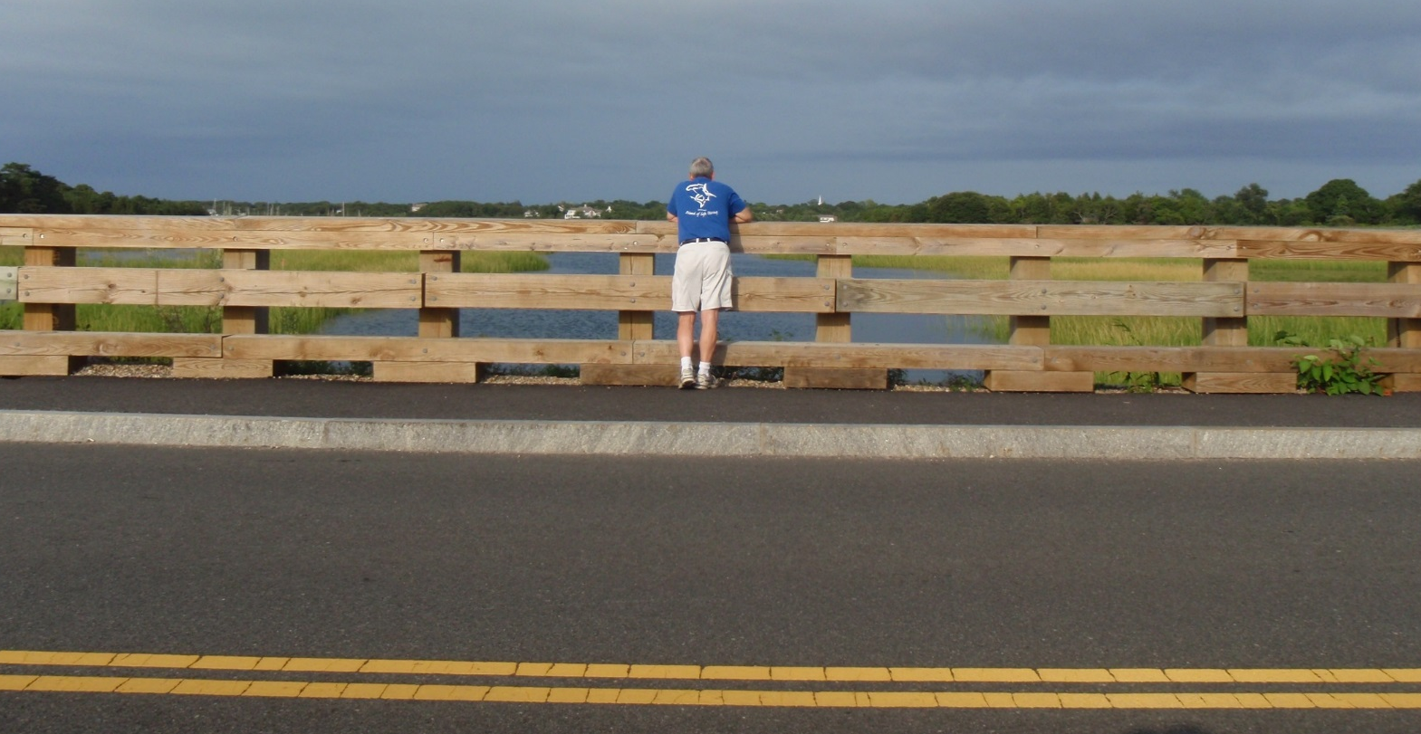
Where to search: bridge or road access
(fishing or aquarium release)
Notes:
Where to search? Where people are

Slide 10
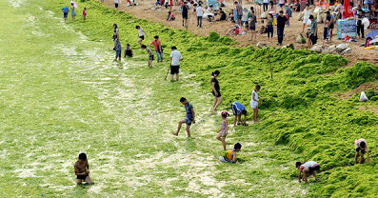
Where to search: downwind shores
Fragments can be directed by wind or currents to concentrate at the shoreline or along docks.
Notes:
Fragments can be directed by wind or currents to concentrate at the shoreline or along docks.

Slide 11
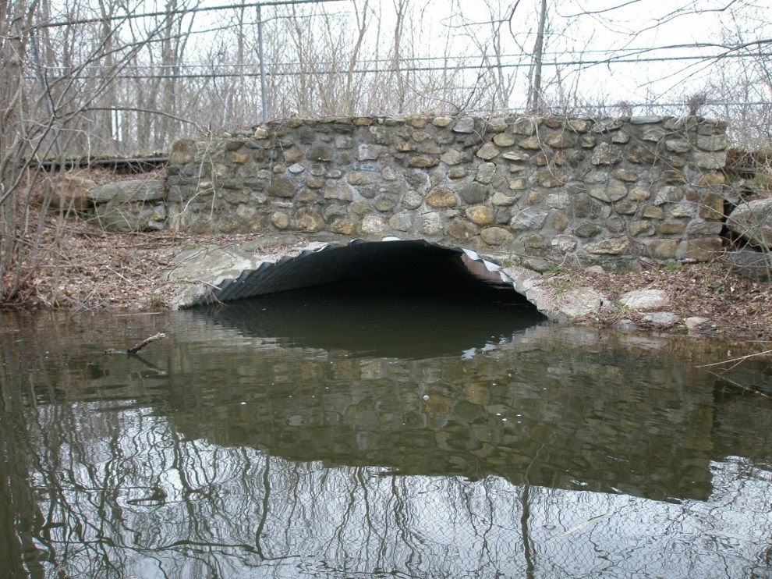
Where to search…
Lake outlet
Stream inlet
Near other known invasives
Weedbeds

Slide 12
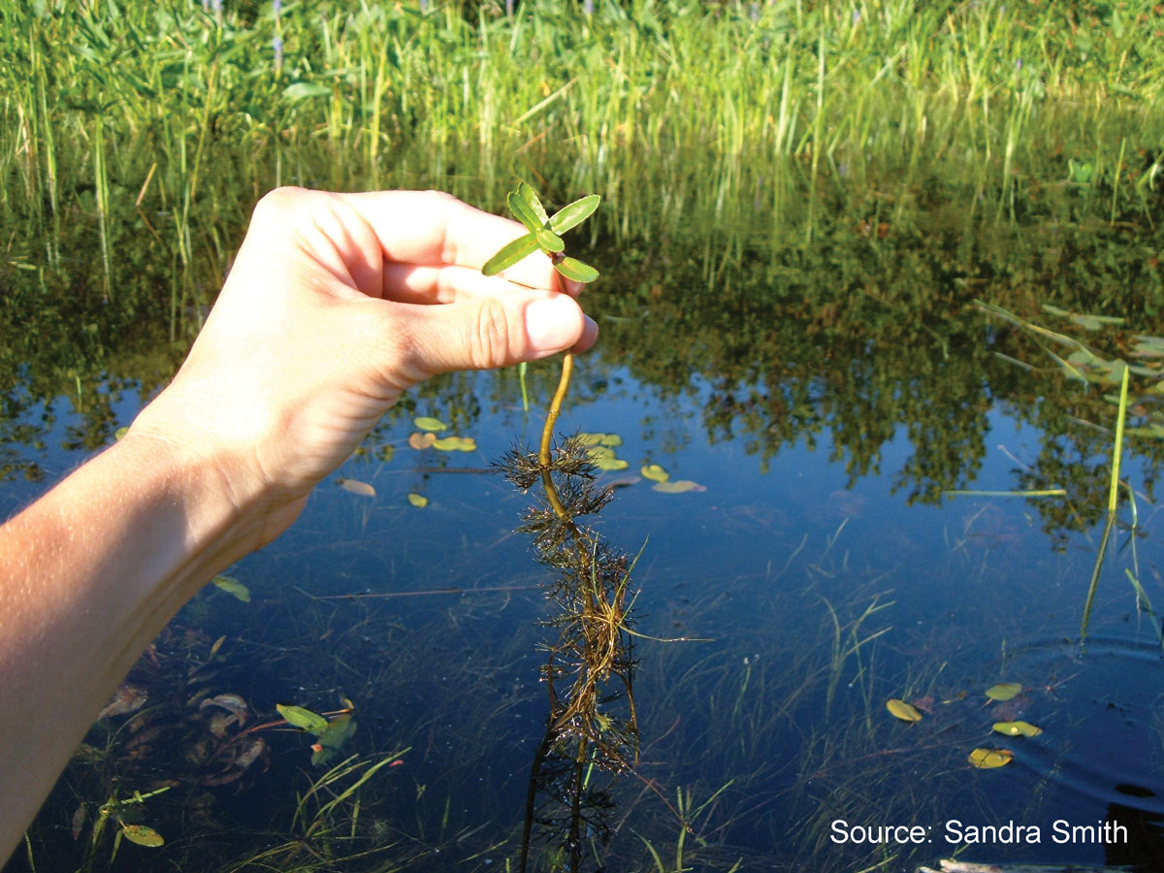
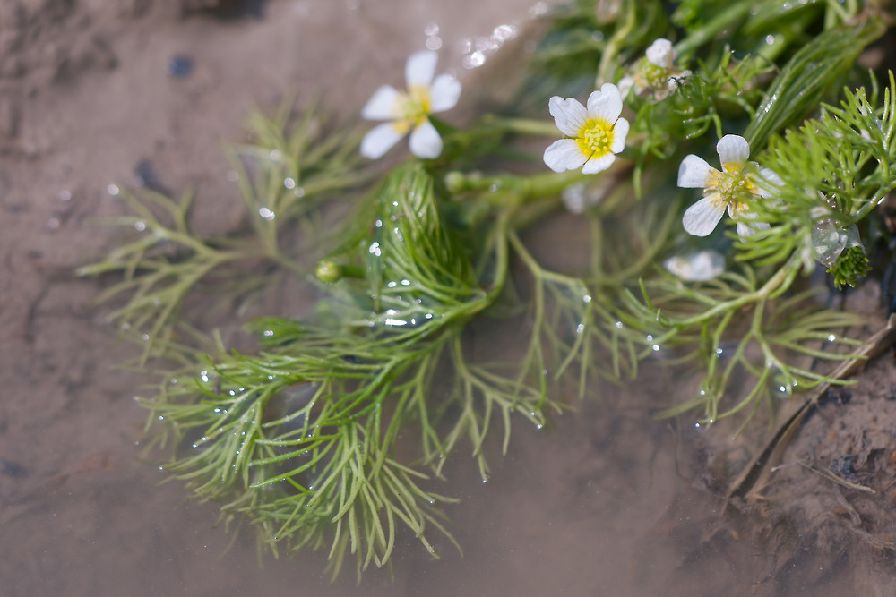
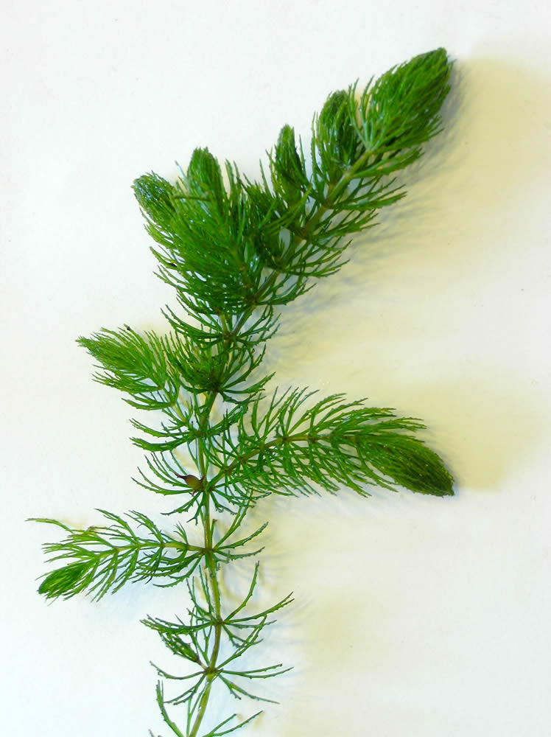
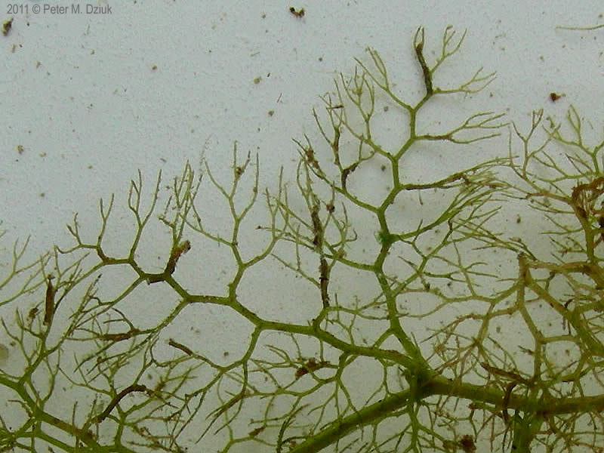
Fanwort lookalikes
Water marigold
(Megaladonta beckii)
Water crowfoot / buttercup
(Ranunculus sp.)
Coontail
(Ceratophyllum demersum)
Bladderwort
(Utricularia sp.)

Slide 13
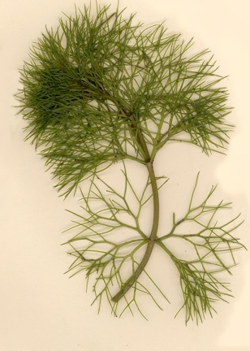
Fanwort vs. Water Marigold
Fanwort
Fan-like leaves
Opposite leaves
Petiole
Water marigold
Not (quite) fan-like leaves
Opposite to whorled leaves
No petiole

Slide 14
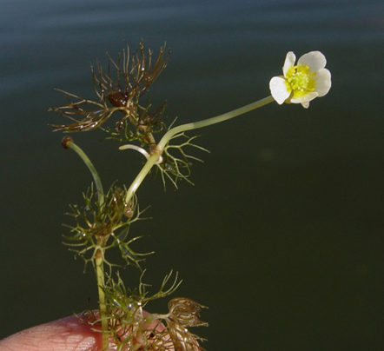
Fanwort vs. Water Crowfoot / Buttercup
Fanwort
Fanlike leaves
Opposite leaves
Petiole
Water crowfoot / buttercup
Not fan-like leaves
Alternating leaves
Petiole

Slide 15
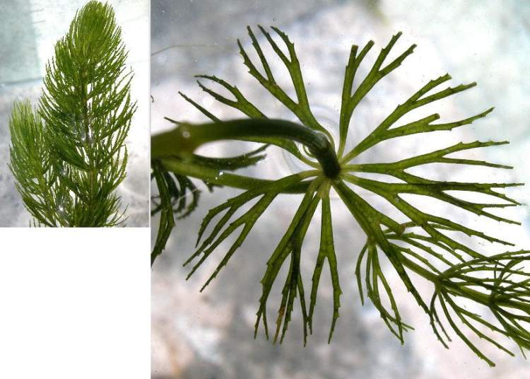
Fanwort vs. Coontail
Fanwort
Fanlike leaves
Smooth leaf margins
Opposite leaves
Coontail
Sorta fanlike leaves
Serrated margins
Whorled leaves

Slide 16
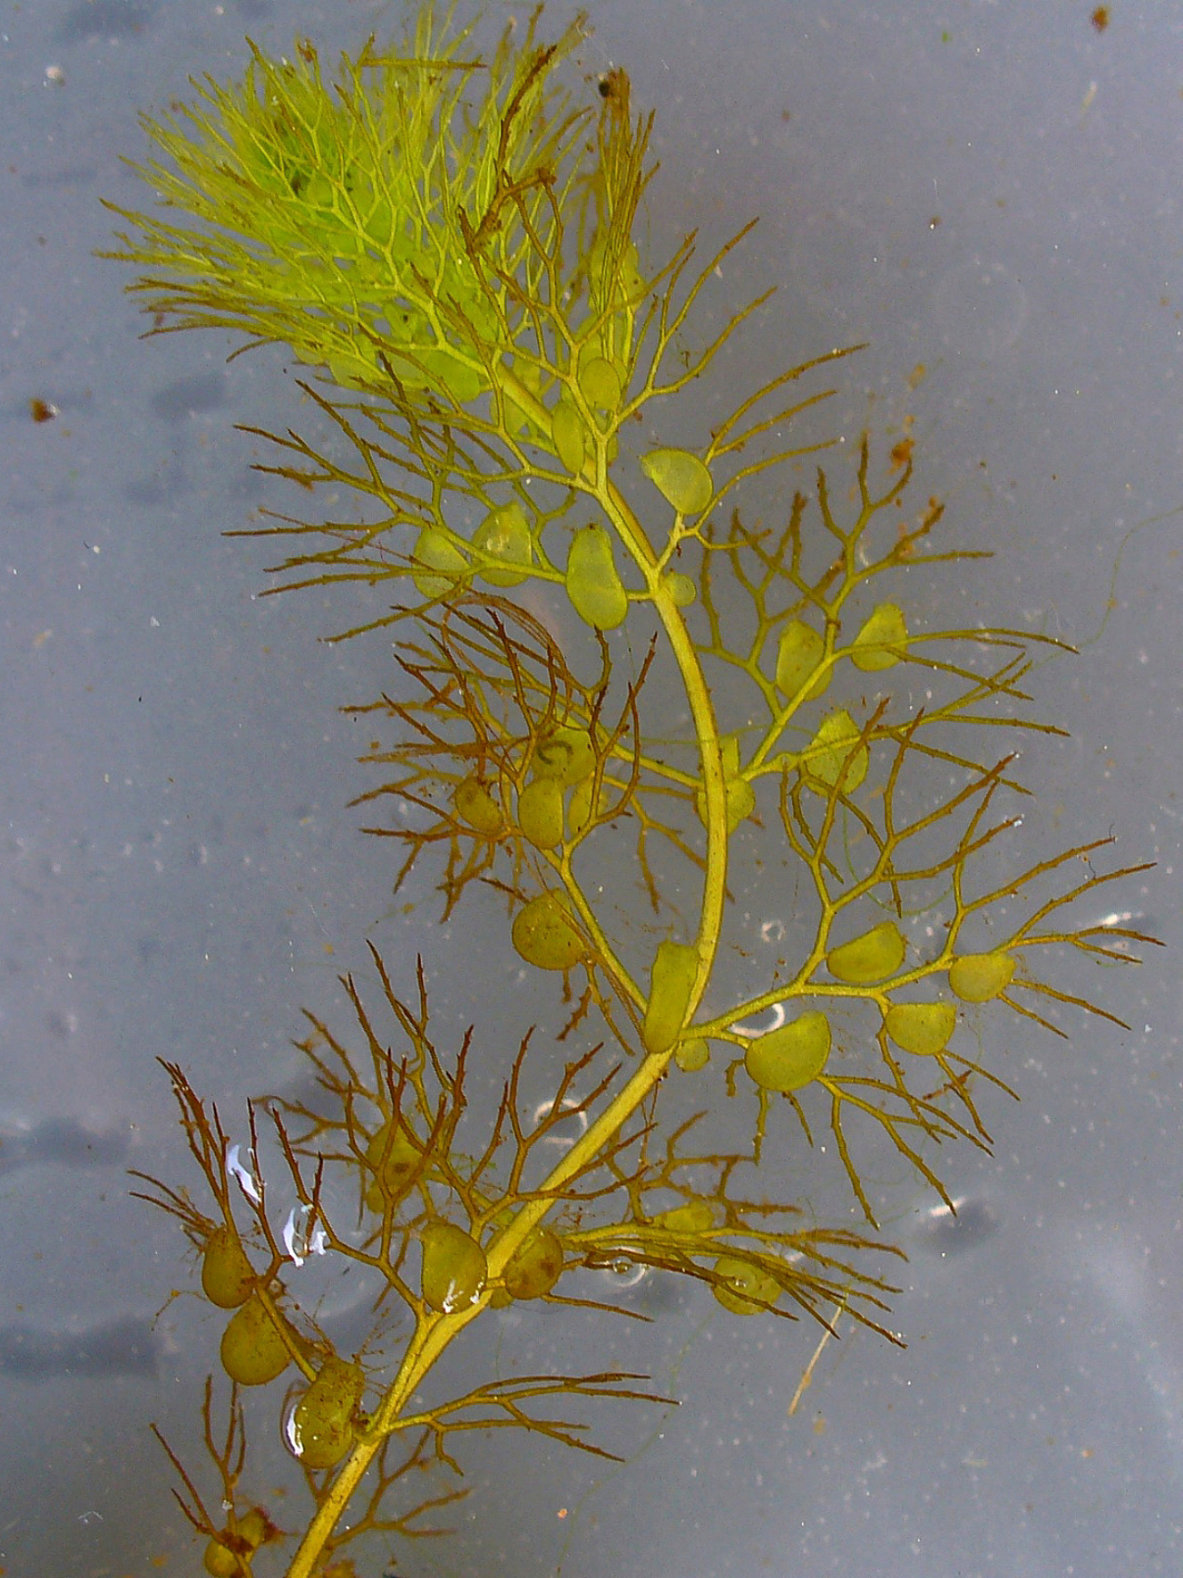
Fanwort vs. Bladderwort
Fanwort
Fan-like leaves
No bladders
Bladderwort
Not fan-like leaves
Distinct bladders

Slide 17
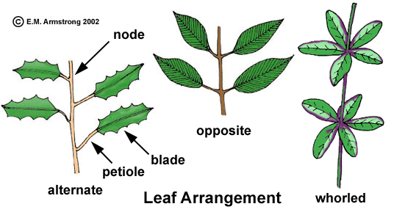
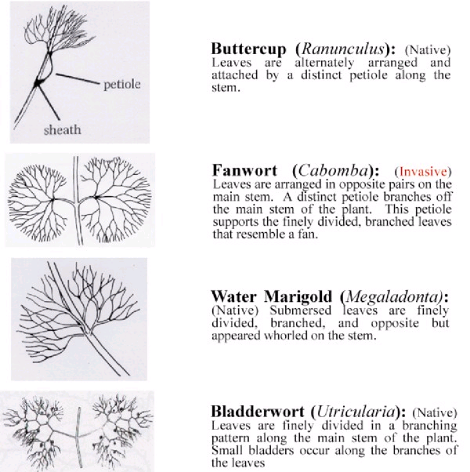
Fanwort-
Key features / distinguishing from lookalikes?
Key Features
  Fanlike thread leaves
  Opposite leaves
  Petiole
  Purplish stem
How Lookalikes Differ
  Water marigold- no petiole
  Buttercup- alternate leaves
  Coontail- serrated margin
  Bladderwort- no fan

Slide 18

How to manage or control fanwort:
A shopping list of management actions
Management actions discussed in detail in Diet for a Small Lake
Available on NYSDEC website (http://www.dec.ny.gov/chemical/82123.html)
Chapter 6 discusses each topic in detail

Slide 19

Specific issues in the
Kasoag Lake/ Fish Creek / Oneida Lake system
Logistics
  No dam or ability to contain grass carp in Fish Creek/Oneida Lake
  Herbicide options limited by retention time (Fish Creek), big lake (Oneida)
  Varying densities of plant
  Varying habitats
  Potential impact to fisheries resources?
Location location location
  Multiple waterbodies used for multiple purposes
  High profile system
Other
  Appetite for starting down a long duration control pathway?
  Permitting issues?
  Management costs
  Monitoring costs

Slide 20
What is the goal?
• Eradication - total destruction and removal of the infestation;
• Control - active measures to suppress the AIS;
• Containment - actions taken to limit the further distribution of the AIS into other waterbodies;
• Watch – observation of the AIS, its spread and the occurrence of adverse impacts resulting from the introduction;
• Mitigation – actions taken to minimize any adverse impacts caused by the AIS infestation;
• Restoration – returning environmental conditions to what existed before the AIS infestation occurred

Slide 21
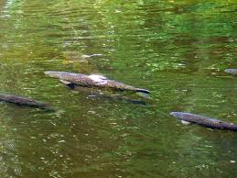
Summary of fanwort control actions to date
Herbicides- contact (endothall) and systemic (fluridone)
  Fluridone: Donahue Pond (Long Island): 2005-2008, Kasoag Lake: 2016
Grass carp
  Belmont Lake (Long Island) – 2008/2009
Hand harvesting
  Belmont Lake (Long Island) – 2008/2009
Benthic barriers
  Belmont Lake (Long Island) – 2008/2009
Dredging
  (Lower) Yaphank Lake (Long Island) – 2013
Mechanical Harvesting
  Silver and Long Lake (Dutchess County)– 2000s
Drawdown (draining)
  Mill Pond (Saratoga County)– late 1990s

Slide 23

Do Nothing Option
Principle- Let nature or apathy work
Pros- (No)$, may take advantage of normal cyclical patterns
Cons- Problem may become more difficult to manage
Permits- None
Costs- Pay later
Viability for Fanwort- Potential risk of expanding growth- not preferred option (will NOT control or eradicate)

Slide 24
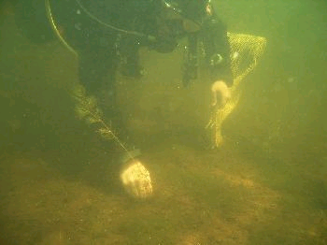
Hand / Suction Harvesting
Principle- Pluck (nudge) ‘em out, one at a time (and bag ‘em)
Pros- Can be cheap, target individual plants or plant species, combine with suction harvesting, good IPM technique
Cons- Labor intensive, difficult and costly > 1000 ft² or deep water, spread fragments
Permits- DEC general AIS permit
Costs- Labor only to $100-500/ac (suction = $5-10k/ac)
Viability for Fanwort- may be good technique for small plots but less practical for large plots

Slide 25
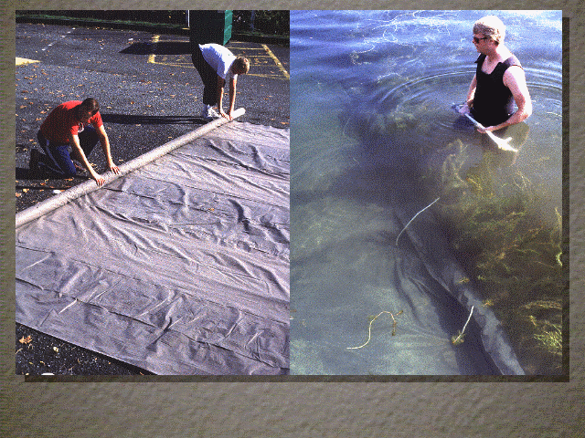
Benthic Barriers
Principle- Smother ‘em
Pros- Focus on use impacted areas, can move to different areas, variable time options
Cons- Difficult in deep water, limited to small areas, potential ecological impacts, not species specific
Permits- DEC general AIS permit; some DEC regions- only If large scale (ECL Article 15, Article 24), USACE if navigable water
Costs- $100/ac + Labor to $10-30k/ac
Viability for Fanwort- all plants can be controlled if barrier placed as plants emerge, but limited to small plots

Slide 26
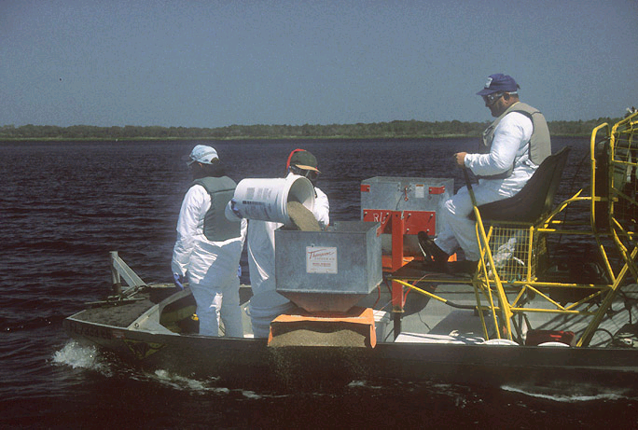
Aquatic Herbicides
Principle- Chemically wipe out weeds by contract or impact to growth pattern
Pros- Short to long term control, some selectivity, local or lakewide control, usually effective
Cons- Non-target impacts, controversial, some limits on use, time delays, plan /monitoring required
Permits- DEC ECL Article 15/Part 327, Article 17/SPDES General Permit, Article 24)
Costs- $300-1500/ac
Viability for Fanwort- mostly endothall and fluridone used

Slide 27
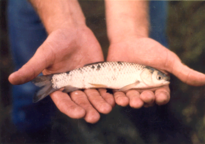
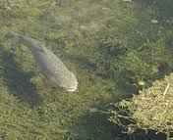
Grass Carp
Principle- Stock weed eating fish
Pros- Perceived “natural”, less expensive, long-term control, mostly invisible control
Cons- Non-native fish, non-target control, risk of algal blooms/ plant eradication / escape, habitat alteration, hard to remove, EIS required
Permits- DEC Stocking Permit (ECL Article 11)
Costs- $50-300/ac
Implications for Fanwort- among preferred plant species, but limited to waterbodies with available containment

Slide 28
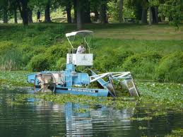

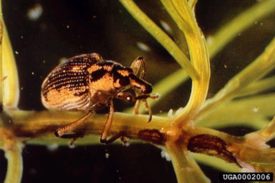
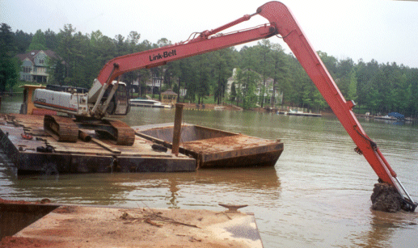

Other options and why they’re not….
Cutting or Harvesting
  Creates fragments for new plant growth
  May not remove sufficient subsurface growth
Shading (chemical colorants)
  Non-selective, non-localized
  Little evidence of control
Herbivorous insects
  None cultivated for fanwort control
  Delayed response- no immediate action
Drawdown
  Limited only to nearshore beds, not deep beds
  Likely significant impact to benthos
Dredging
  Limited at best to localized areas
  May be too expensive for most lake/shore communities

Slide 29
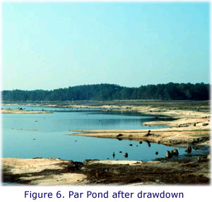
IPM = Integrated Plant Management
Principle- Combining two or more management techniques
Pros- ^ likelihood of long-term control, 1-2 punch, favorably viewed as more comprehensive, can combine local and large scale management
Cons- Must make sure techniques are compatible, side effects could multiply
Permits- Varied
Costs- Varied

Slide 30
For more information
AERF “Biology and Control of Aquatic Plants” (3rd edition)
http://www.aquatics.org/bmp.html
University of Florida/Center for Aquatic and Invasive Plants
https://plants.ifas.ufl.edu/plant-directory/cabomba-caroliniana/
Fanwort control in Belmont Lake (NYS Parks and Recreation)
http://nysparks.com/environment/documents/posters/BelmontLakeStateParkFanwortControl.pdf

Slide 31
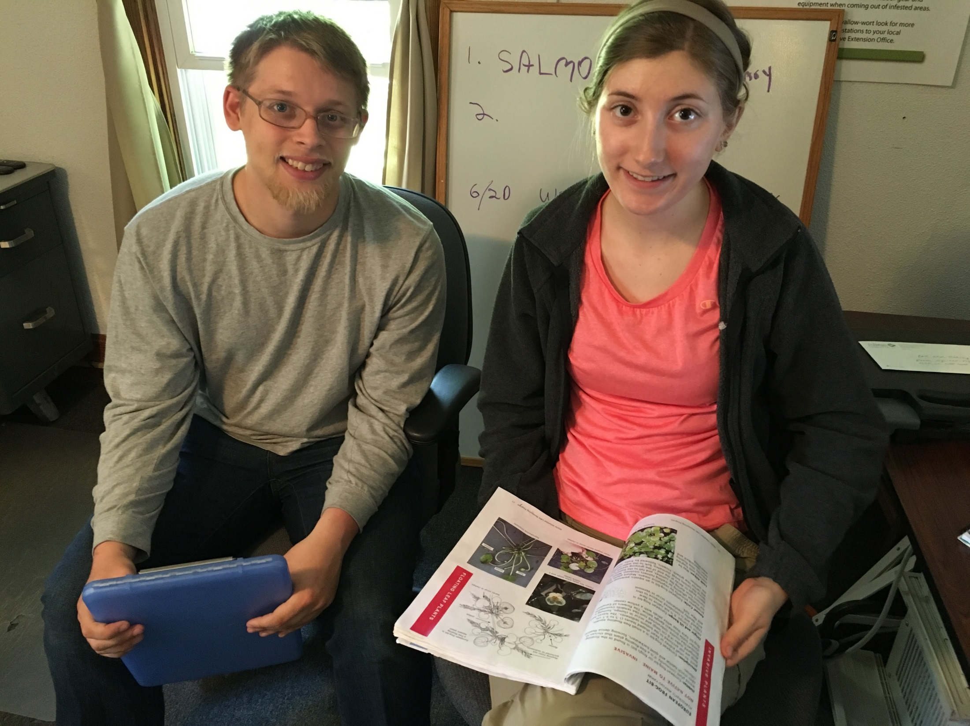

Slide 32
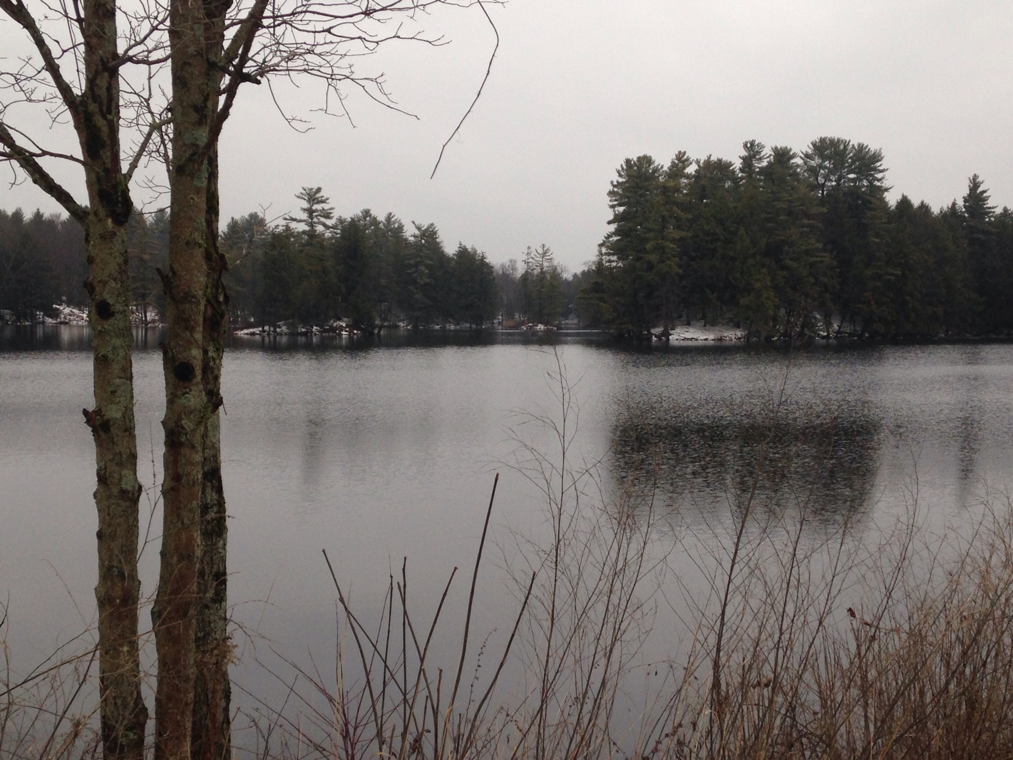
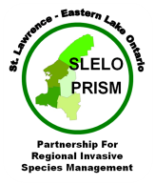
Kasoag Lake Outlet
West Branch Fish Creek
Fanwort Assessment
St. Lawrence Eastern Lake Ontario
Partnership for Regional Invasive Species Management
Teaming up to stop the spread of invasive species
Rob Williams, SLELO PRISM Coordinator
John DeHollander, Project Contact
Kasoag Lake
Rob Williams 2015 ©

Slide 33
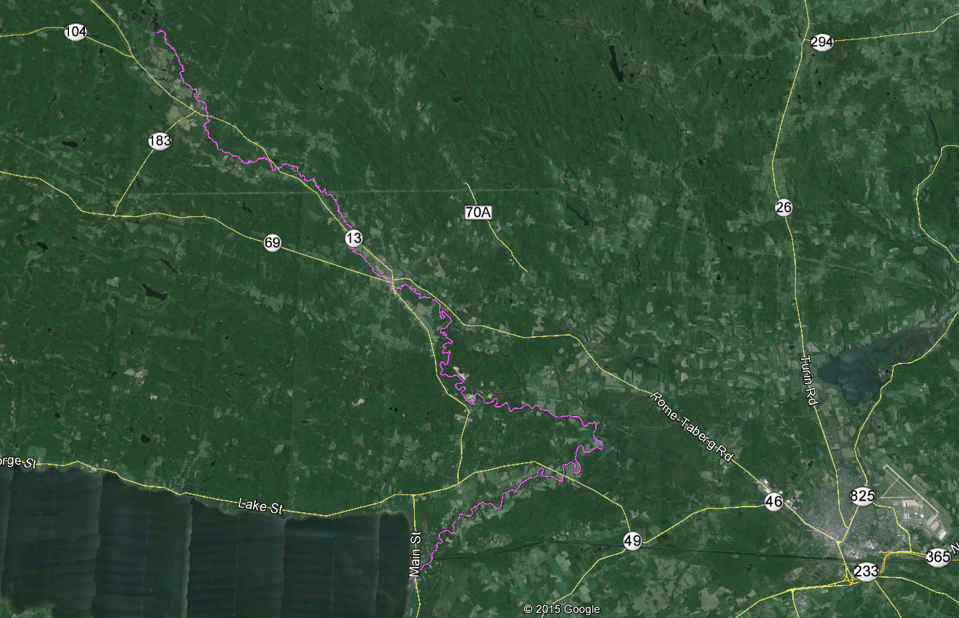
Kasoag Lake
Practical Overview - West Branch Fish Creek
Kasoag outlet to Oneida Lake Inlet = 47.9 miles
Meandering, linear and braided compartments.
Varies from shallow, swift moving waters to lentic waters.
Some stream segments are not accessible/navigable.
Oneida Lake

Slide 34
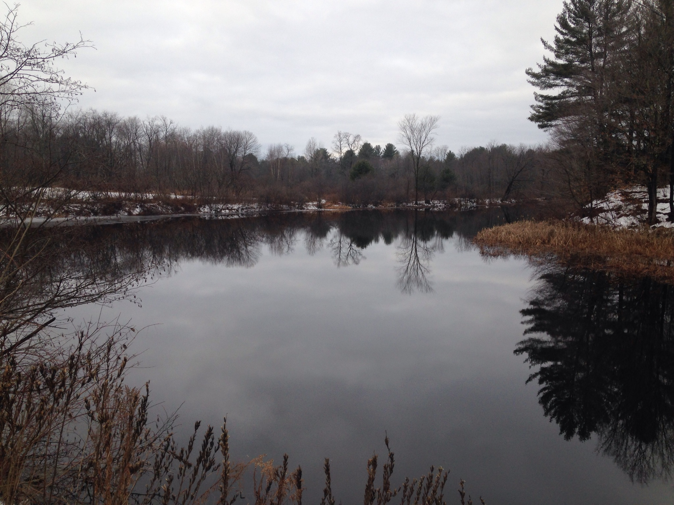
Approach to initial assessment:
Highly Probable Areas (HPA’s)
(areas where there is an increased likelihood of an AIS being introduced or becoming established.
(examples)
Quiet shallow coves with soft sediment.
Calm backwater areas.
Public access sites.
Launch ramps.
Impoundments.
Upstream of Cemetery Rd. Crossing in Westdale.
Rob Williams 2015©

Slide 35
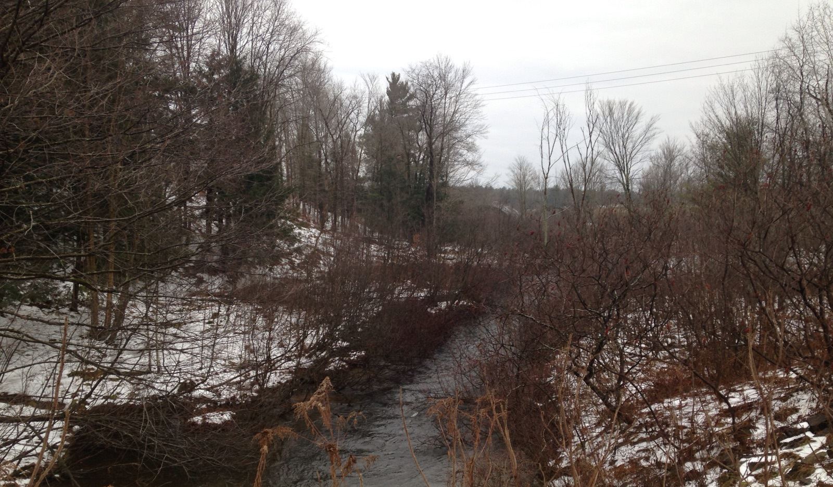
Initial HPA Identification – December 2015
Findings:
Much of the creek is non-navigable.
Mostly private property with several public access points.
HPA’s exist but are somewhat limited.
Recommend we include road crossings as possible HPA’s and as survey access points.

Slide 36
All Potential HPA’s (25)
HPA 1 –Outlet to Kasoag Lake
HPA 2 - Base Bridge Road,ROW access
HPA 3 - Lovers Lane Crossing
HPA 4 - Rt. 17 Crossing
HPA 5 - Rt. 13 Crossing & Pond
HPA 6 – Rt. 13 crossing near Amboy Rd.
HPA 7 – Public Fishing Access near Cemetery Rd
HPA 8 – Owens Road Crossing
HPA 9 – Rt. 13 Crossing near Howard Road
HPA 10 – Mill St. Crossing ROW access
HPA 11 – Railroad Street access
HPA 12 – Mexico St at Rt. 69 access
HPA 13 – Main Street access
HPA 14 – Brewer Street access
HPA 15 – Blakesley St. Access
HPA 16 – Buell St. access
HPA 17 – Trestle Rd. access
HPA 18 – Mill Pond Way Land Access
HPA 19 – McConnellsville Rd. Acess
HPA 20 – Rt. 66 Overpass ?
HPA 21 – Old Oswego Rd. Access
HPA 22 – Rt. 49 access ?
HPA 23 – Public Launch Ramp & Boat Access near
Rt. 50-A
HPA 24 – Quiet Shallow coves near Oneida Lake
Recommended Starting HPA’s (10)
HPA | Upstream | Downstream
Base Bridge Rd. | Shore toss | Shore toss
Lovers Lane | Canoe or shore toss | Shore toss
Co. Rt. 17 | Shore toss | Shore toss
State Rt. 13 Williamstown | Canoe | Shore toss
State Rt. 13 Westdale | Canoe and shore toss | Canoe and shore toss
Cemetery Road | Canoe | Shore toss Caution - falls
State Rt. 13 between Pennymix and Howard Roads | Canoe or shore toss | Canoe or shore toss
Mexico St. Camden | Shore toss | None
Trestle Road Crossing | Canoe | Canoe
Oneida Lake Inlet | Canoe | Canoe

Slide 37
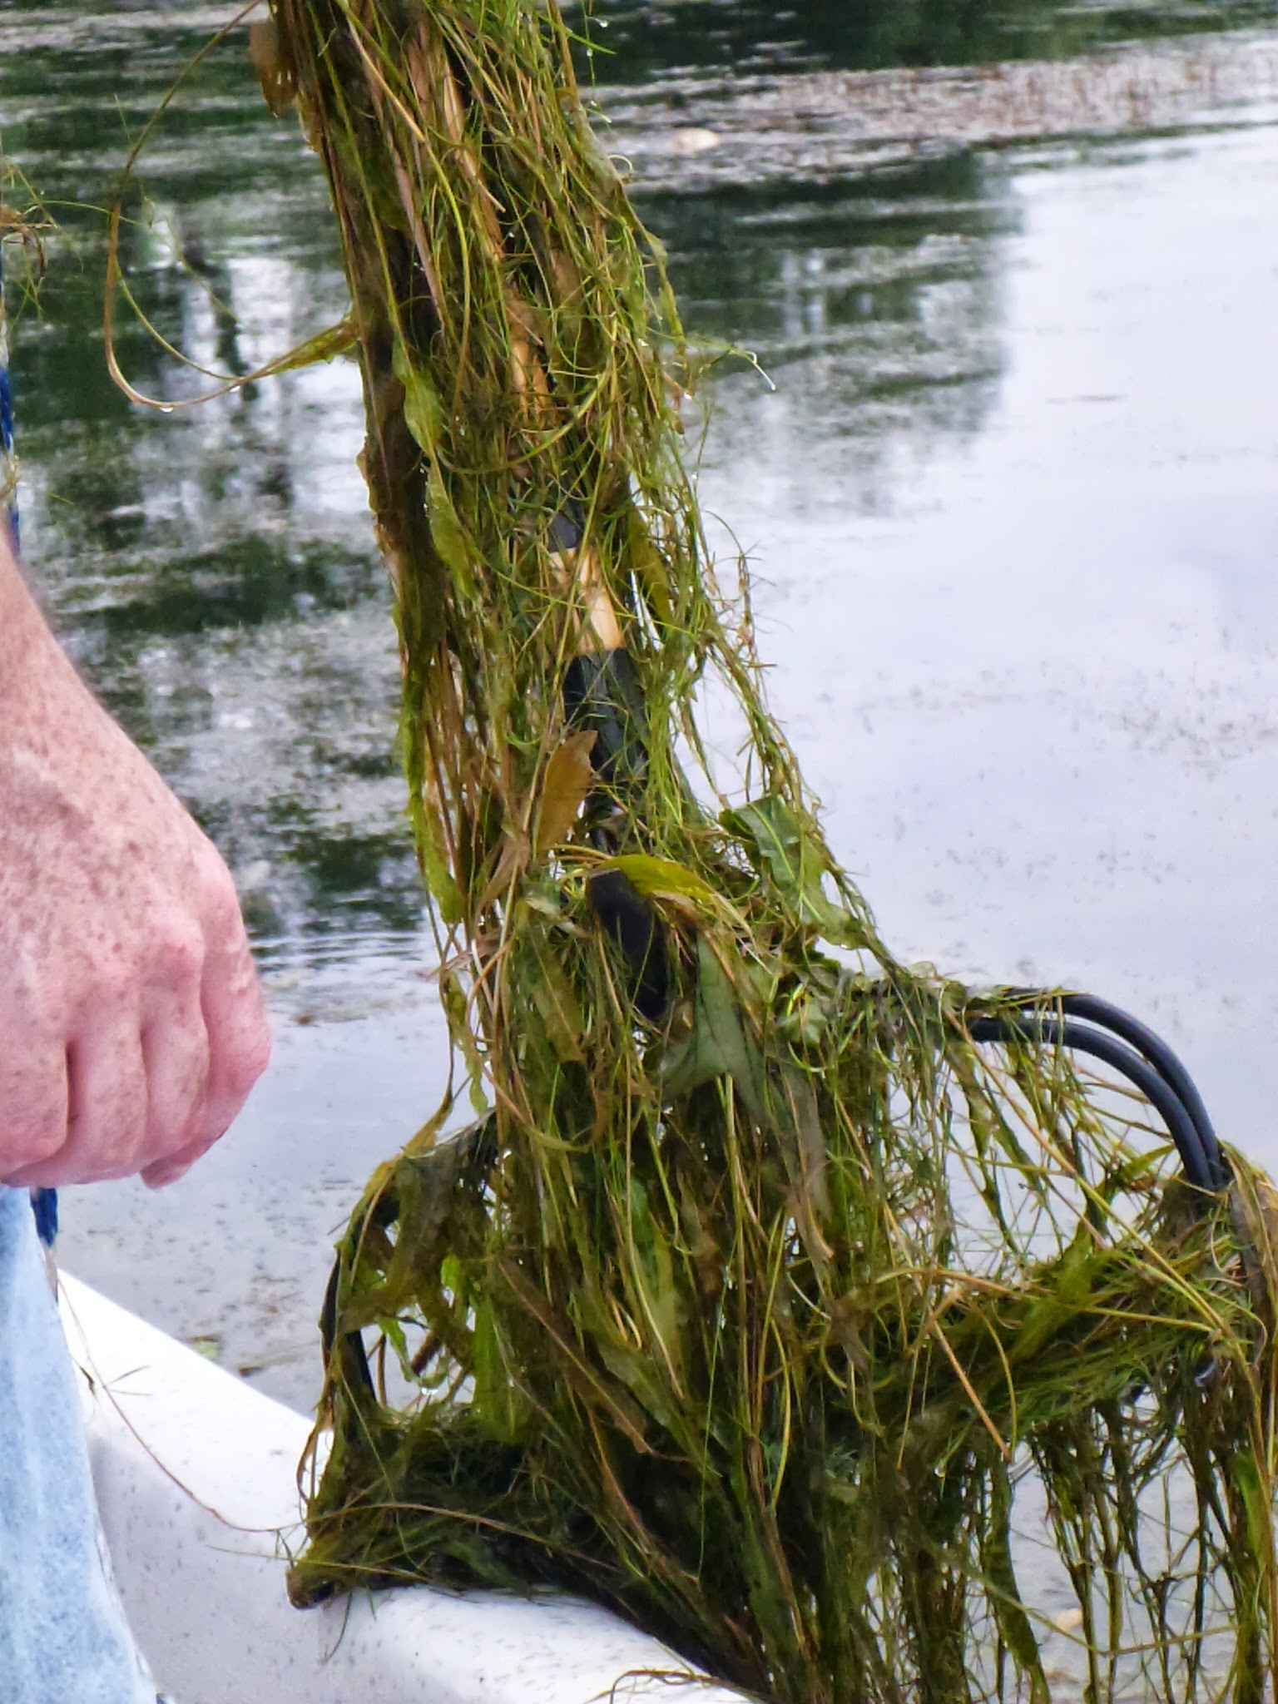

Slide 38
2.
Heaviest concentration of sample sites below Kasoag Lake.
1.
 | Recommended Starting HPA’s (10)
HPA | Location | Upstream | Downstream
1 | Base Bridge Rd. | Shore toss | Shore toss
2 | Lovers Lane | Canoe or shore toss | Shore toss
3 | Co. Rt. 17 | Shore toss | Shore toss
4 | State Rt. 13 Williamstown | Canoe | Shore toss
5 | State Rt. 13 Westdale | Canoe and shore toss | Canoe and shore toss
6 | Cemetery Road | Canoe | Shore toss Caution - falls
7 | State Rt. 13 between Pennymix and Howard Roads | Canoe or shore toss | Canoe or shore toss
8 | Mexico St. Camden | Shore toss | None
9 | Trestle Road Crossing | Canoe | Canoe
10 | Oneida Lake Inlet | Canoe | Canoe
1
2
3
4
5
6
7
8
3.
If fanwort is found at any given HPA, additional HPA’s can be surveyed and fanwort populations can then be estimated. May require access to private property.
9
10

Slide 39
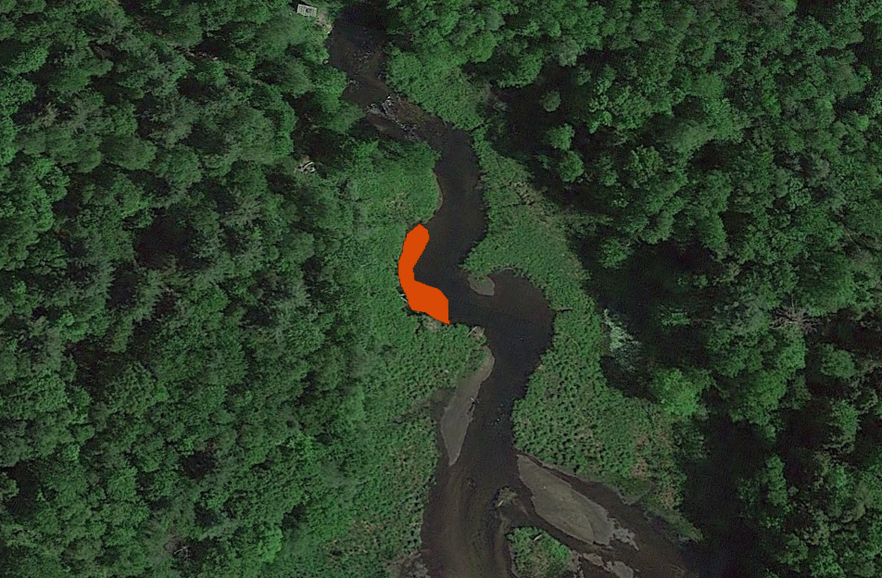
Infested areas determined via GIS
e.g.. 0.03 acres or 122 meters²

Slide 40
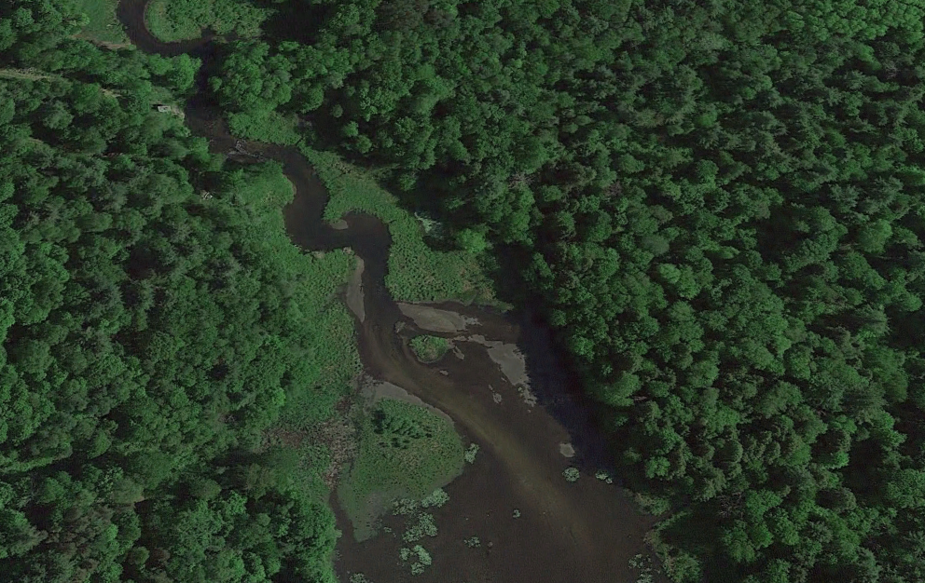
Data collection
Waypoint | Latitude | Longitude | Depth | # of Species | # of invasive | Invasive species present | Notes
HPA 2 | 44.21972 | -76.10354 | 5 feet | 2 | 0 |  | Visual: Frogbit, Rake Toss 1 -Eurasian Water Milfoil
 |  |  |  | 3 | 1 | Eurasian Milfoil Frogbit
HPA 4 | 44.17916 | -76.14239 | 3 feet | 3 | 0 |  | Visual: Frogbit
 |  |  |  | 4 | 1 | Frogbit
HPA 6 | 44.23062 | -76.08946 | 3 feet | 1 | 0 |  | Visual: Frogbit, Phragmites, Purple Loosestrife Rake Toss 1&2 Eurasian Water Milfoil,
 |  |  |  | 4 | 1 | Eurasian Water Milfoil Frogbit
HPA 7 | 44.18848 | -76.13439 | 5 feet | 3 | 0 |  | Visual: Frogbit
 |  |  |  | 2 | 0 | Frogbit

Slide 41
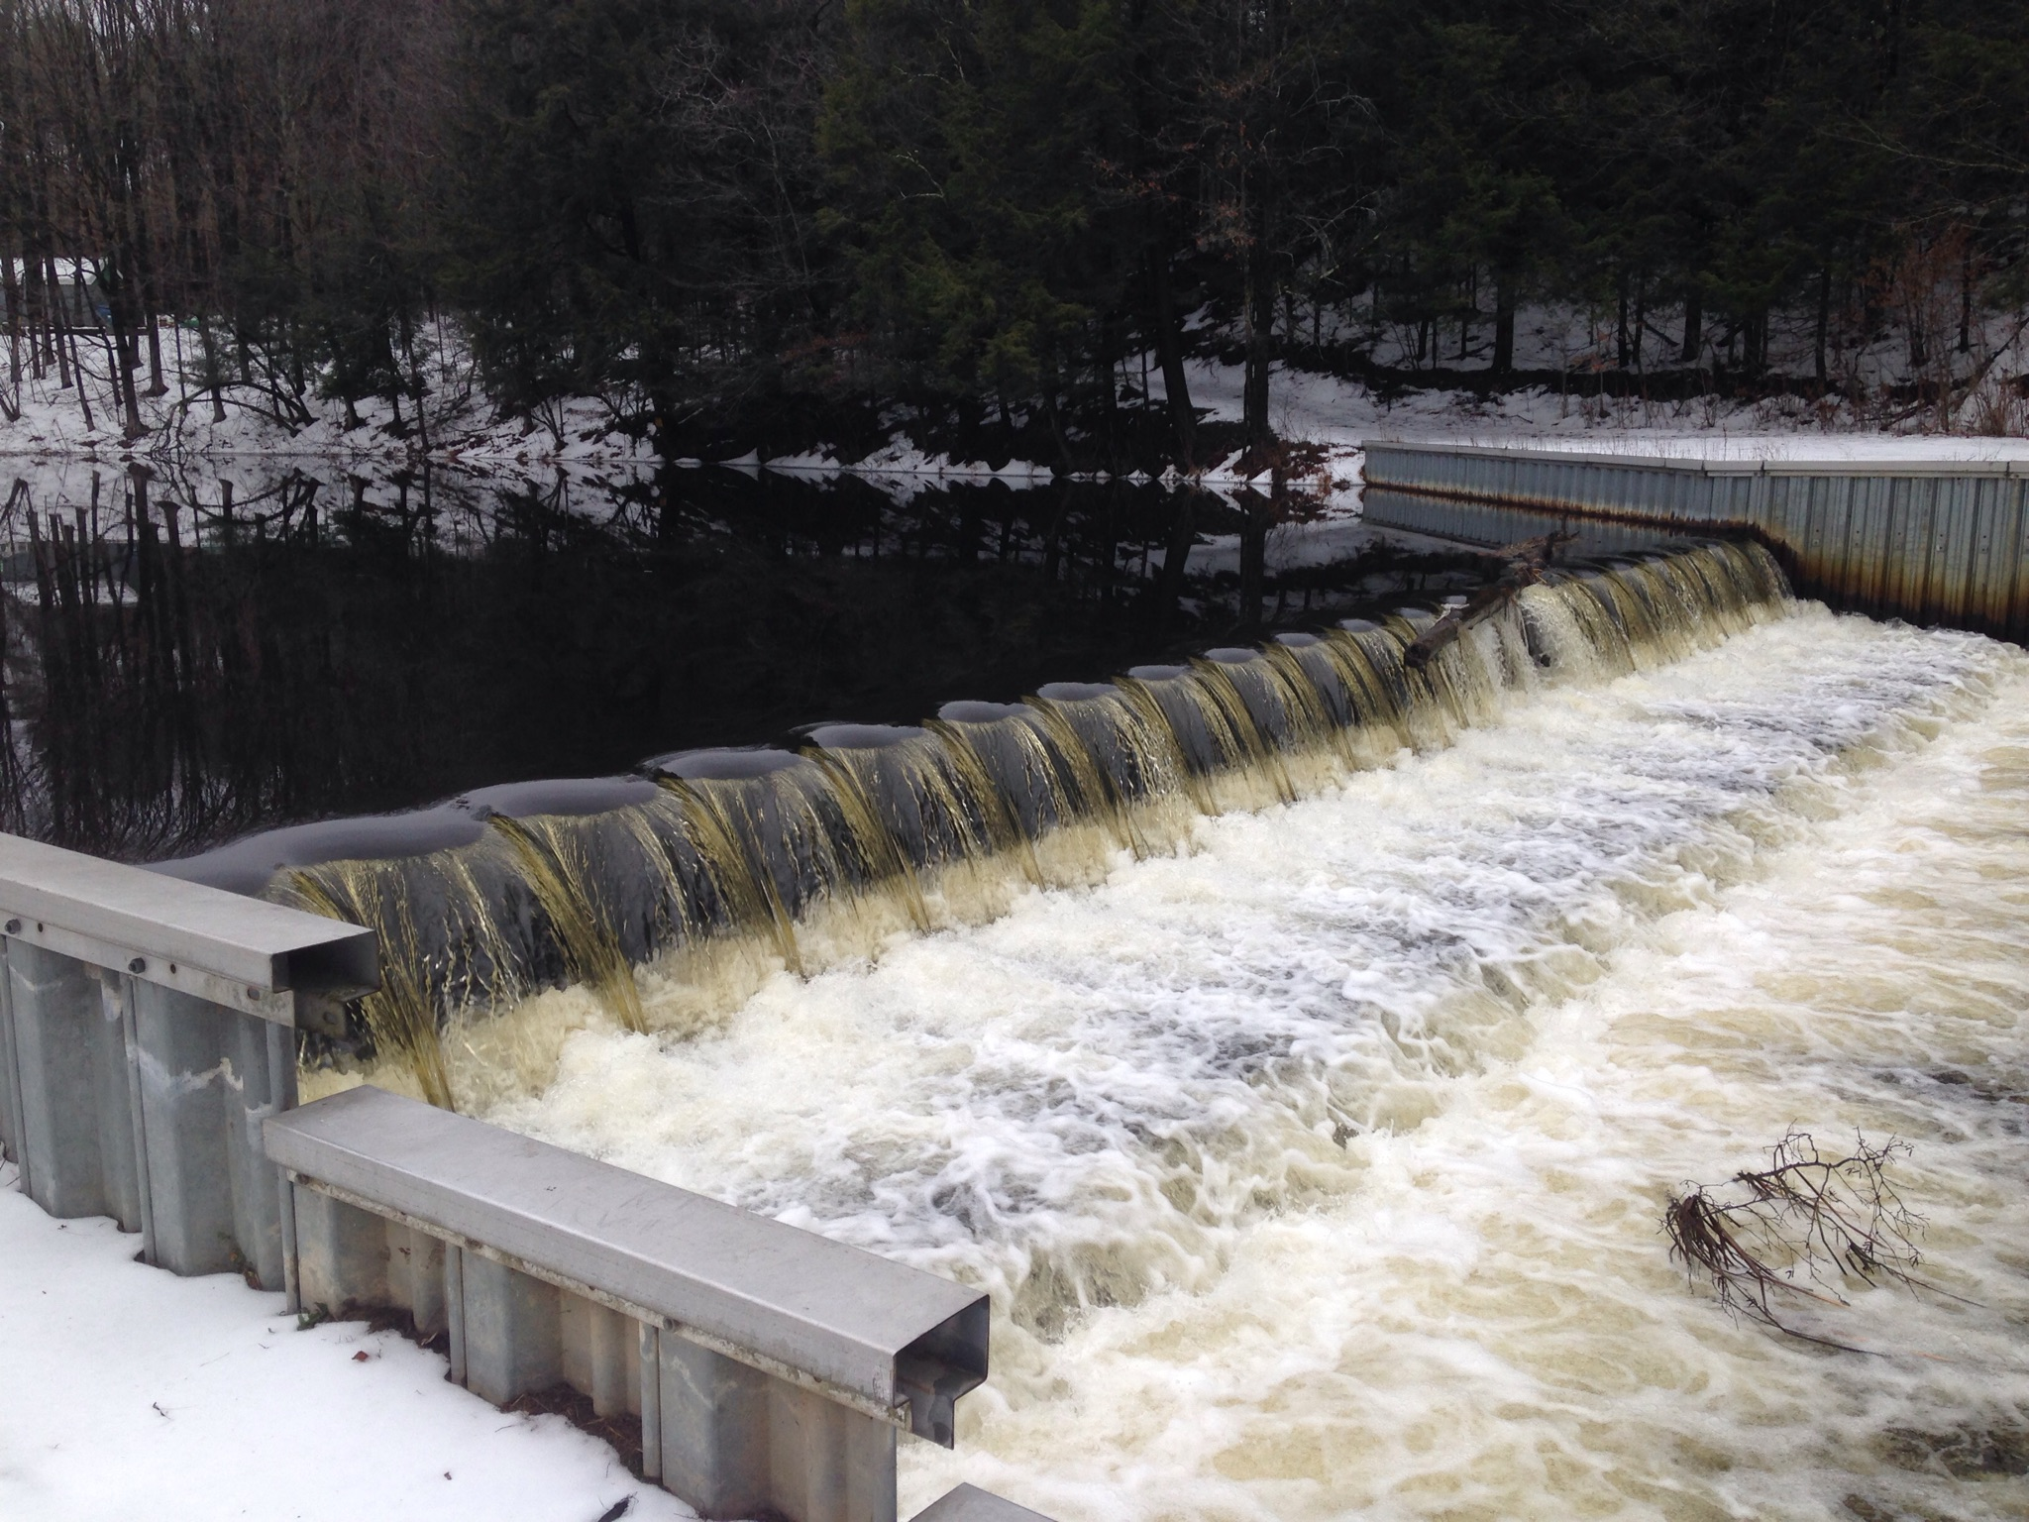
Hazards exist near some HPA’s so safety will be paramount.

Slide 42
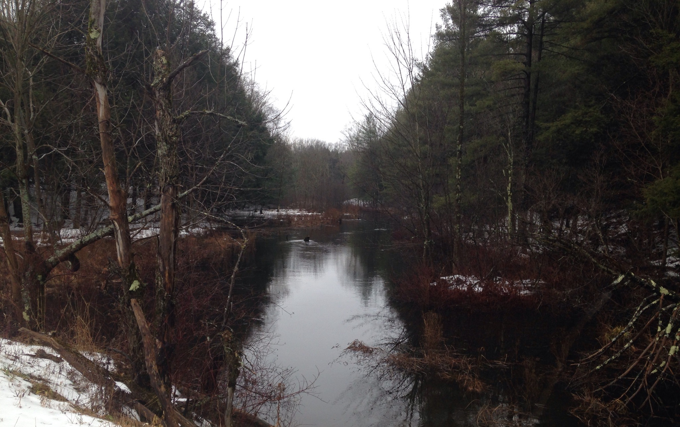
Approach Summary:
The SLELO PRISM Early Detection Team can conduct the initial survey.
If fanwort is found and additional HPA’s are added and depending on the # added, SLELO team can conduct more surveys but may require assistance (volunteers).
Crossing at Lovers Lane. Looking Upstream
Rob Williams, 2015 ©

Slide 43
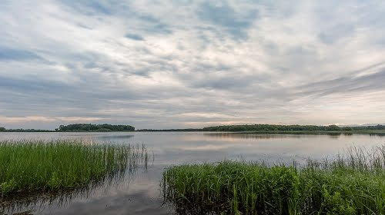
Invasive Species to Watch For

Slide 44
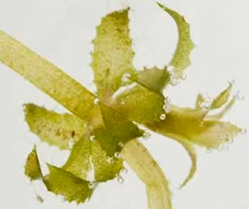
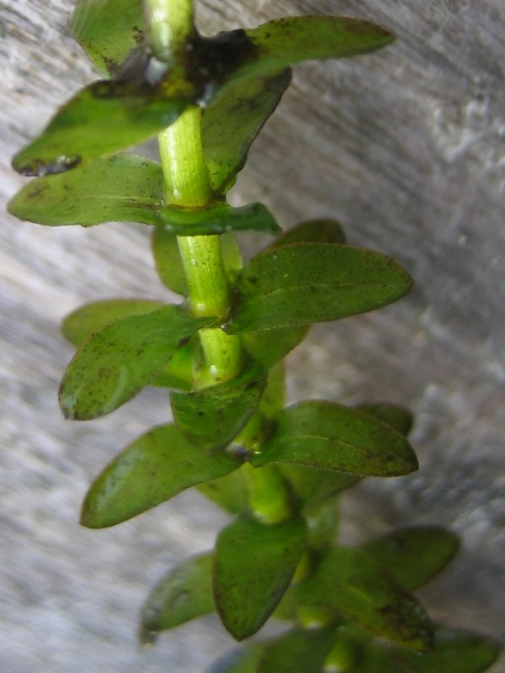
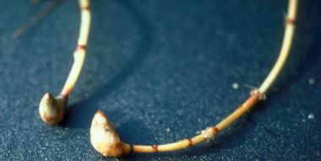
WATCH/PREVENTION SPECIES: Hydrilla (Hydrilla verticillata)
Native Range/ Introduction
Indian subcontinent, Korea/Imported
Ecological Threat:
-Aggressively spreads and dominates native, beneficial, aquatic plants.
-Renders surface waters unusable for passive recreation and fishing.
-Winter dieback may reduce dissolved oxygen levels.
Hydrilla has 4 or more leaves per whorl and visible serrated leaf margins and tubers.
Look alike!
Elodea has 3 leaves per whorl, no serrations and no tubers.
Best Control:
Mechanical harvesting and herbicide spraying are common control methods for Hydrilla. Both are expensive and only moderately effective.
Hydrilla tubers
Notes:
Native Range/Introduction:
There are two different reproductive types of Hydrilla; one type has female flowers, while the other has both male and female flowers on the same plant.
Hydrilla plants with only female flowers are believed to originate from the Indian subcontinent, whereas hydrilla plants with both female and male flowers are believed to be from Korea.
Southern populations are predominantly plants that have only female flowers that overwinter as perennials. Populations north of South Carolina, including populations in New York, have both male and female flowers on the same plant that set some fertile seed, and depend on tubers for overwintering.
Identification:
Hydrilla is a submerged aquatic plant that roots in the bed of a waterbody. It has long stems (up to 25 feet in length) that branch at the surface where growth becomes horizontal and forms dense mats. Leaves are small (2 - 4 mm wide, 6 - 20 mm long), pointed, often serrated and arranged around the stem in whorls of 4 to 10. It can be distinguished from its native look alike elodea which has only 3 leaves per whorl and no serrations.
Impacts:
Hydrilla is one of the world’s worst aquatic invasive plants. It invades deep, dark waters where most native plants can’t grow. Its stems can grow up to an inch a day reaching 20-30 feet. It blocks out sunlight and suppresses native vegetation. Major hydrilla colonies can alter the physical and chemical characteristics of lakes and deter recreational activities and reduce lakeshore property values.
Spread:
The main means of introduction of Hydrilla is as castaway fragments on recreational boats and trailers and in their live wells. New colonies can often be found near boat ramps as such stem pieces become rooted in the substrate (even very, very small fragments can become the start of new populations). Boat traffic through established populations can shatter and spread Hydrilla throughout the waterbody, similar to the spread of Eurasian watermilfoil.
Control:
Mechanical harvesting and herbicide spraying are common control methods of controlling Hydrilla. Both are expensive and only moderately effective.

Slide 45
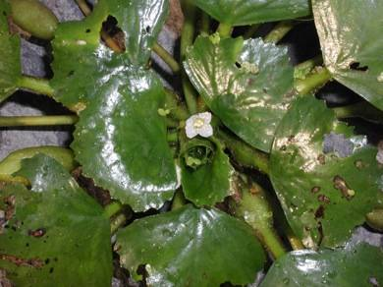




TARGET SPECIES: Water Chestnut (Trapa natans)
Native Range/Introduction
Western Europe, Northeast Asia& Africa/ accidental cultivation
Ecological Threat
This fast-growing, floating perennial forms large mats that completely dominate surface waters.
Renders open waters unavailable to recreation.
Shades out native aquatic vegetation.
Reduces oxygen levels for fish and encourages sedimentation by restricting silt movement.
Hard, pointy seeds can cause injury to feet.
Best Control:
Hand/ Mechanical Harvesting and Chemical application of Clear Cast ® (follow regulations.) Biological control agents are being explored (Galerucella sbspp.)
Because of the severity of its impacts, T. natans has been listed in federal regulations prohibiting its sale and transportation.
Notes:
Native Range/ Introduction:
Water chestnut is native to western Europe, Northeast Asia and Africa. Initial introduction to North America is thought to have occurred during the 1870’s through its’ cultivation in botanical gardens. From these gardens water chestnut is thought to have escaped and has since spread throughout the Great Lakes, and Finger Lakes, as well as, inland lakes and waterbodies throughout the north eastern part of North America and Quebec.
Identification:
water chestnut is an aquatic plant that bears a rosette of floating leaves at the tip of a submersed and rooted stem. Although it grows best in shallow, nutrient-rich lakes and rivers, it can also grow on wet, mucky substrates. (Note that this is not the same species used in Asian cooking).
The name water chestnut refers to the plant’s characteristic fruit which have a nut-like structure segmented into 4 distinct sections, they are about an inch wide and are a greenish-brown color when maturing and black when no longer viable. Each seed can produce 10 – 15 new plants; in turn, each rosette can produce 15 – 20 seeds. Seeds are easily dispersed in water and can remain viable in sediment for 12 years. Unviable nuts turn black and can float to shorelines where they can cause injury to unsuspecting beach goers.
Impacts
This fast-growing, aquatic plant forms large mats that shade out native aquatic vegetation and has the ability to completely dominate surface waters. It reduces oxygen levels for fish and encourages sedimentation by restricting silt movement.
Spread:
Water chestnut is easily spread by plant fragmentation and by seed.
Control: Can be removed mechanically, by hand; A commonly used herbicide is Clear Cast. A number of potential biological control agents were found in field surveys. The most promising biocontrol species appeared to be the leaf beetle Galerucella, the potential of subspecies within this genus as a control agent are currently being researched.

Slide 46

WATCH/PREVENTION SPECIES: Didymo (Didymosphenia geminate)
Native Range:
Species of diatom that is
native to parts of Eurasia
Ecological Threat:
Forms large mats on bottoms of rivers, streams and lakes
Destroys critical habitat for fish and their prey species and disturbs spawning areas
Easily transported on the bottom of fishing waders and in boat ballast water
Best Control:
Prevention is the best control method. Anglers should clean/dry their equipment especially waders before entering/leaving
a body of water.
Notes:
Didymo forms large mats on bottoms of rivers, streams and lakes. These mats can grow so large and dense that they destroy critical habitat for fish and prey species and disturb spawning areas. Didymo is transported by fishing waders and equipment as well as flowing water.
Control:
A new research project at the University of Colorado at Boulder has discovered that high water flows greatly decrease the amount of Didymo in the system. This control method is still being researched and is not yet proven.
To prevent the spread of didymo, Fishermen should check, clean and dry their boots and equipment before entering and leaving a body of water.

Slide 47



WATCH/PREVENTION SPECIES: Rusty Crayfish (Orconectes rusticus)
Native Range:
This freshwater crayfish is thought to be native to the Ohio River Basin.
Ecological Impacts:
Causes severe changes to the aquatic food chain.
Displace native crayfish species
Reduce aquatic plant diversity and abundance
Reduces shelter and food for young game fish and aquatic invertebrates
Distinctive red marks on carapace
Best Control:
Prevent the spread by purchasing native bait fish and throwing out bait in the trash. Do not dump left-over bait in the waterways.
Notes:
Rusty crayfish are an aggressive species with the ability to alter the aquatic food chain in non native ecosystems. Thought to be native to the Ohio River Basin, the rusty crayfish was likely introduced by fisherman who dumped their leftover bait into waterways.
They out-compete native crayfish species for food and disrupt the entire aquatic food web. They also reduce plant abundance and diversity which reduces the available habitat for fish, ducks and young gamefish that rely on submerged aquatic plants for food, shelter and spawning.

Slide 48



Slide 49


Slide 50


