Slide 1
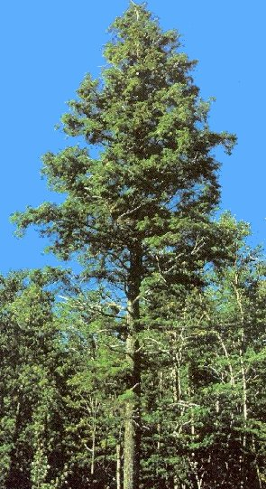
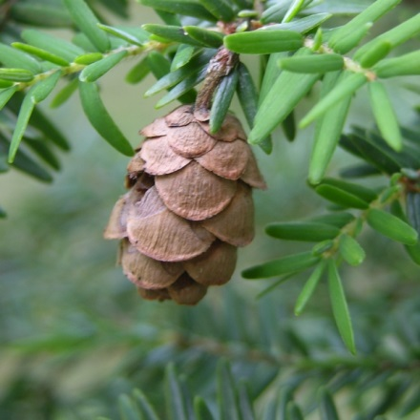
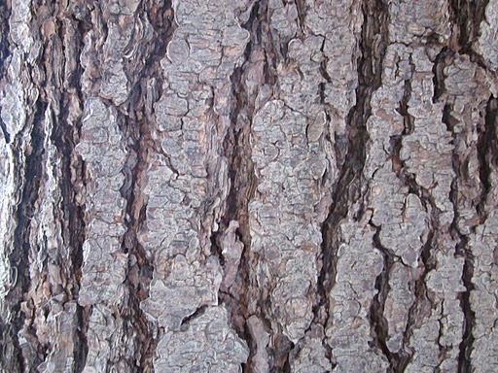
I am an Eastern Hemlock Tree
I am a native tree species in Northern NY
I provide food and shelter to a wide variety of wildlife
I contribute to the ecosystem in a variety of ways
The invasive species called, Hemlock Woolley Adelgid can make me sick and kill me.

Slide 2
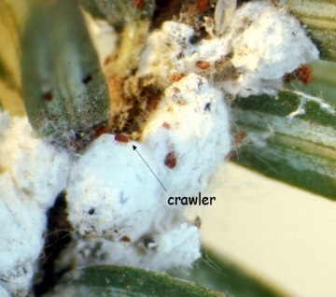
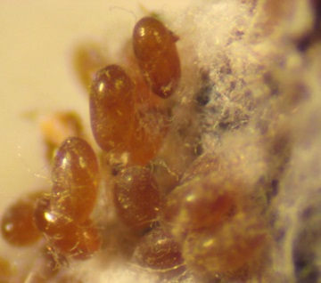
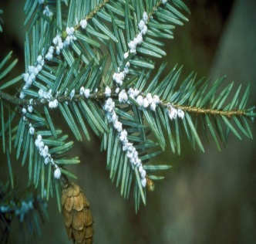
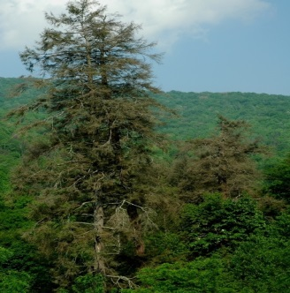
I am a Hemlock Woolley Adelgid (HWA) (an invasive species)
I am a small, aphid-like insect native to Asia that is now threatening eastern hemlock and Carolina hemlock trees in the United States.
I feed on the tree’s food storage cells, disrupting nutrient flow, eventually killing the tree’s needles and causing death to the tree.
You can help slow the spread of HWA by not transporting hemlock trees from tree nurseries in one region to another.

Slide 3
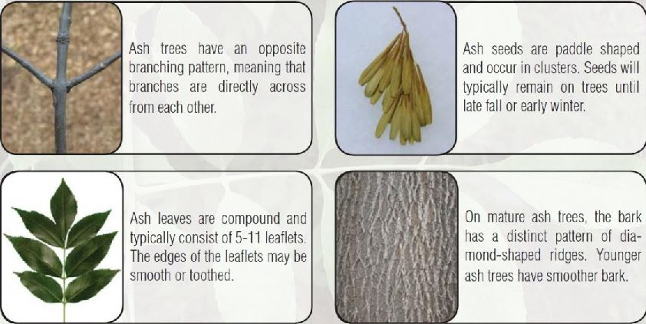
I am an Ash Tree
My most common relative in NY is the White Ash Tree.
My other relatives include Green Ash and Black Ash.
Wood from my trees is desirable in the lumber industry and I provide food and habitat for wildlife.
The invasive species called, the Emerald Ash Borer has killed over 70 million of my relatives in the US!

Slide 4
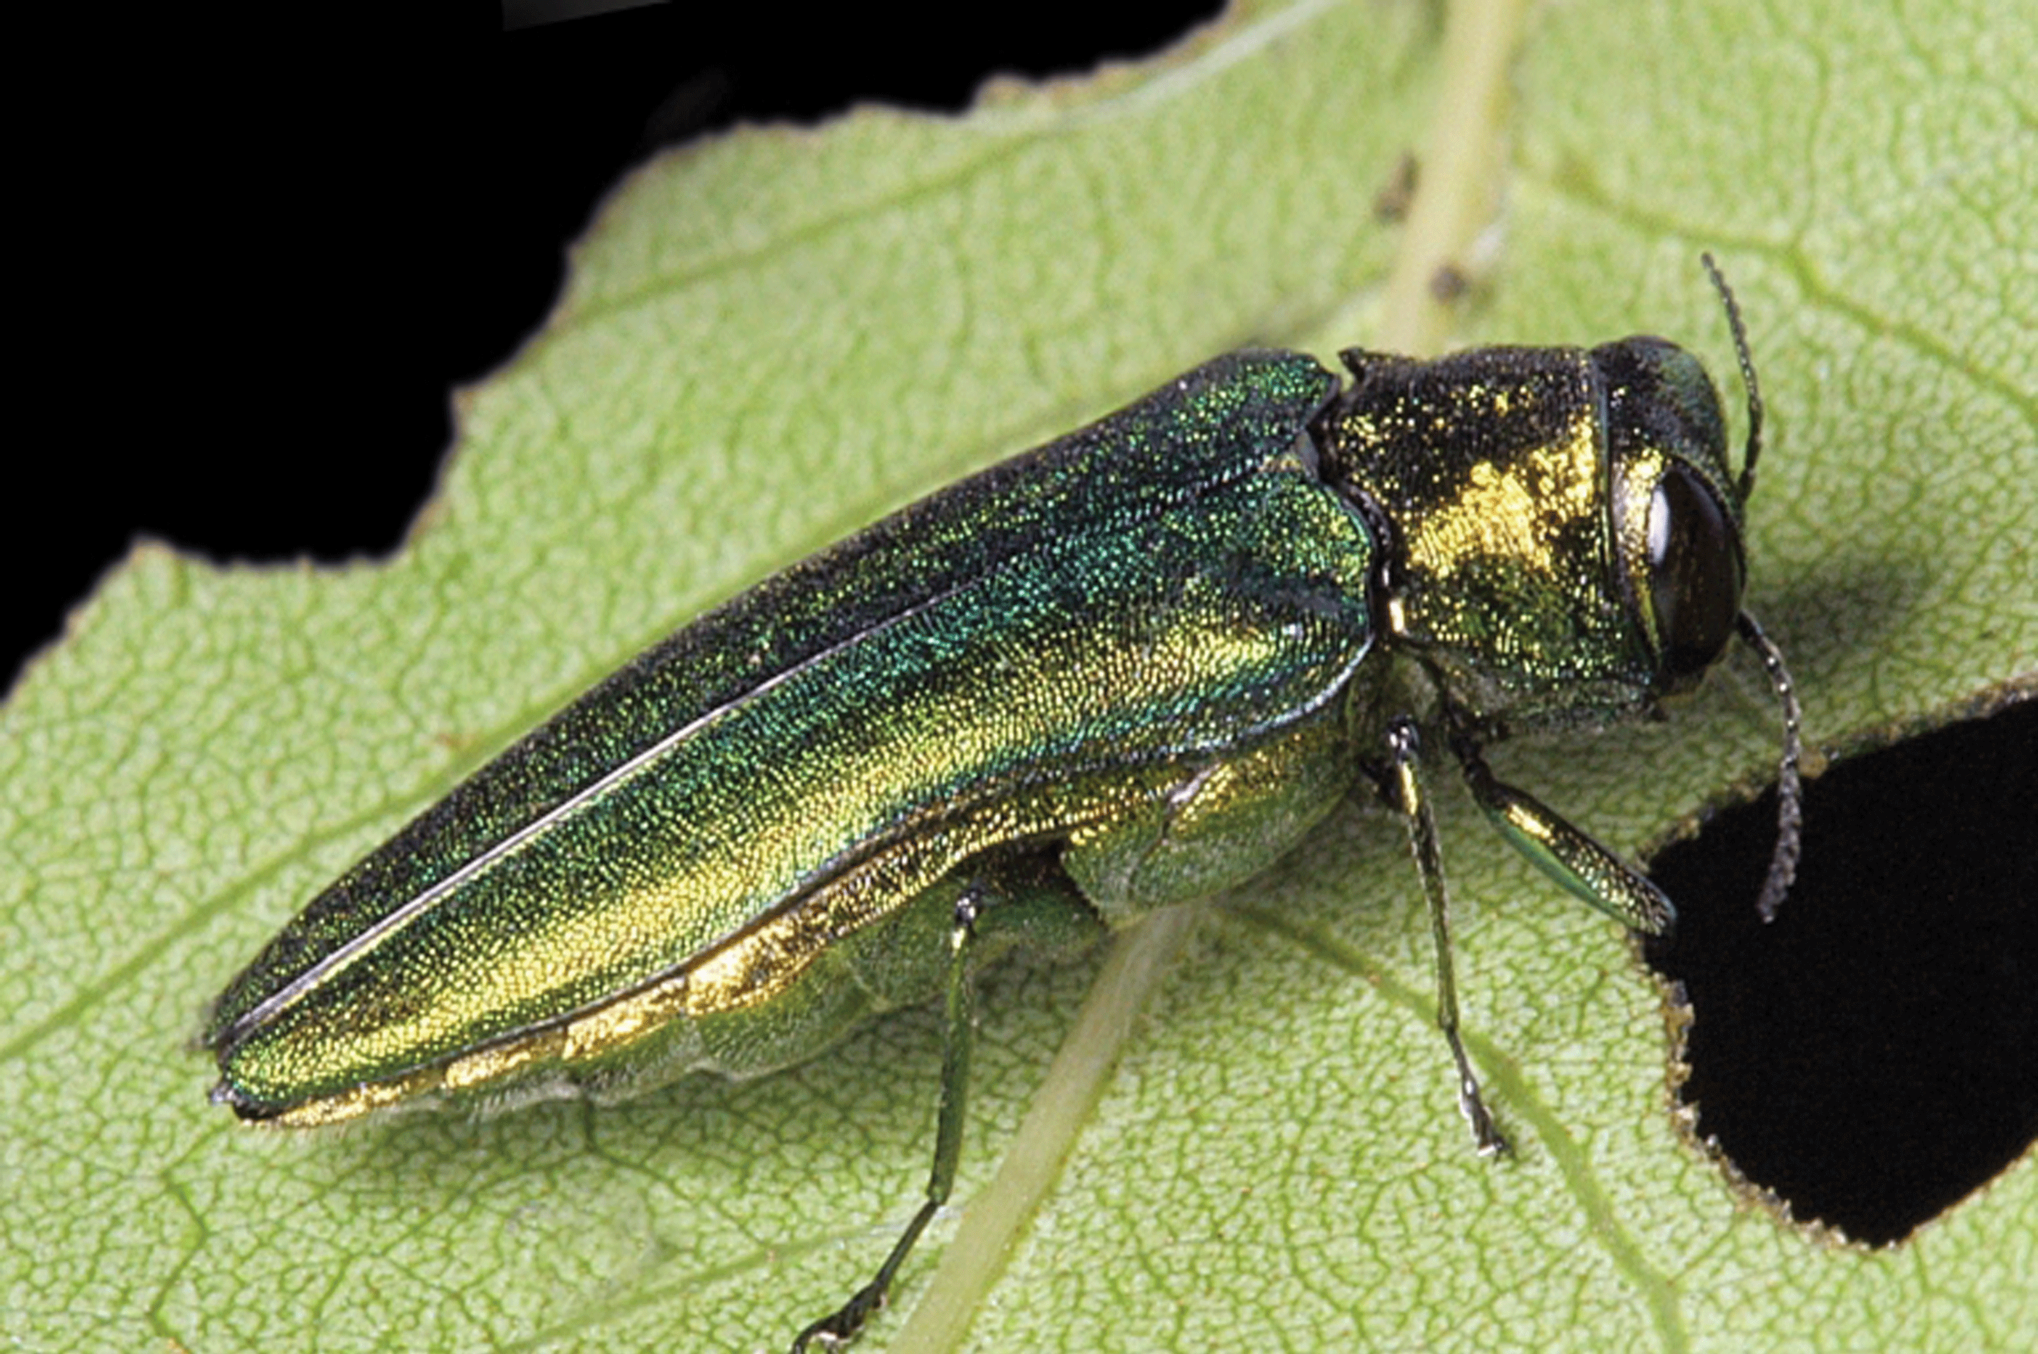
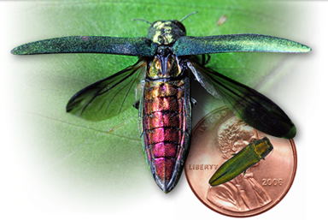
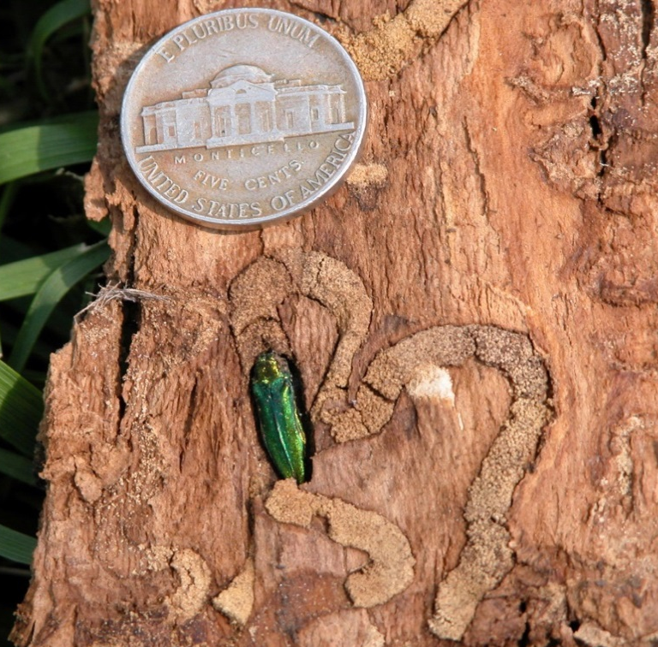
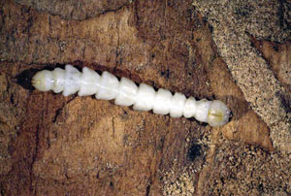
I am an Emerald Ash Borer (EAB) (an invasive species)
I am native to Asia and I target and kills ash tree species.
My larval stage feeds under the bark of trees, cutting off the flow of water and nutrients. Infested trees gradually die over a 2-4 year period.
You can help slow my invasion by not transporting firewood!

Slide 5
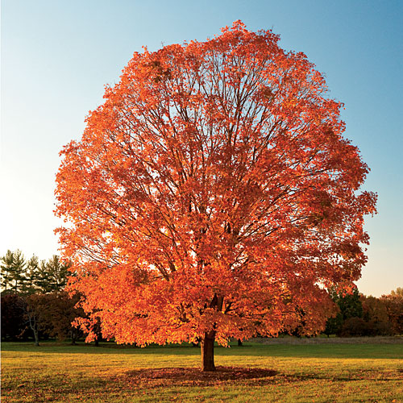
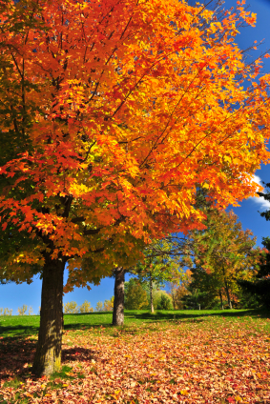
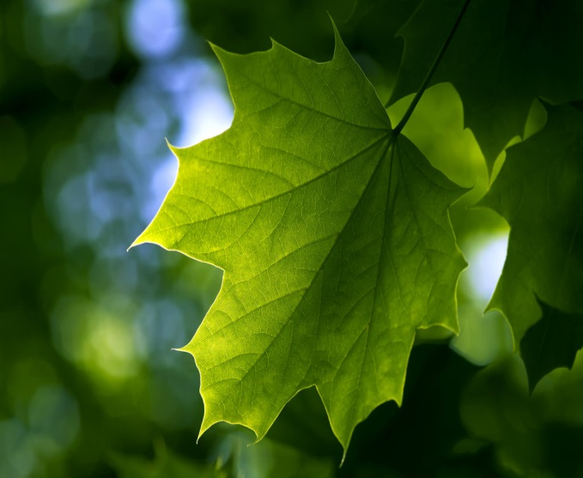
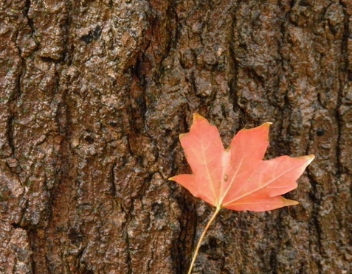
I am a Maple Tree
There are 13 maple tree species in North America; 4 are native to New York. Sugar maples are the NY state tree.
I am a valuable hardwood species and I produce maple syrup.
I provide food and habitat for wildlife.
I am pretty famous for my beautiful fall foliage.
The Invasive Species called, the Asian Long Horned Beetle targets me and other hardwood trees causing our deaths.

Slide 6
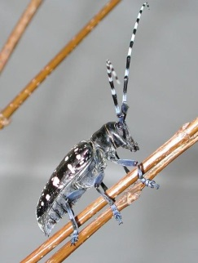
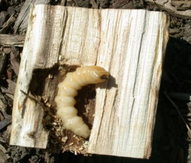
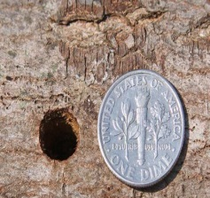
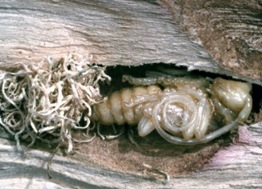
I am an Asian Longhorned Beetle (ALB) (an invasive species)
I am a wood boring insect that is native to China and Korea.
I target several species of hardwood trees (maple, birch, elms horse-chestnut are some of ALB’s preferred species).
My larvae bore through the woody tissue of host trees disrupting the flow of nutrients and water, eventually killing the tree.
You can help slow my spread by not transporting firewood.

Slide 7
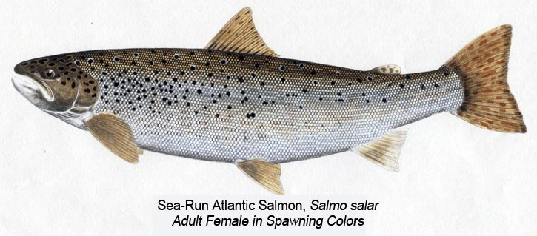
I am an Atlantic Salmon
There are two different groups of salmon found in New York; Atlantic salmon which are native and stocked Pacific Salmon (Chinook, Coho and Kokanee)
I am an important sportfish and predatory aquatic species.
My populations can be reduced by the invasive species called a Sea Lamprey.

Slide 8
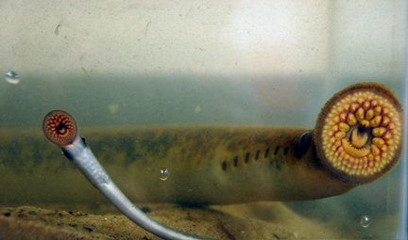
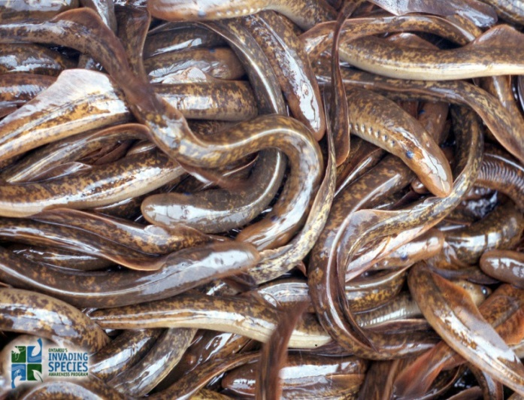
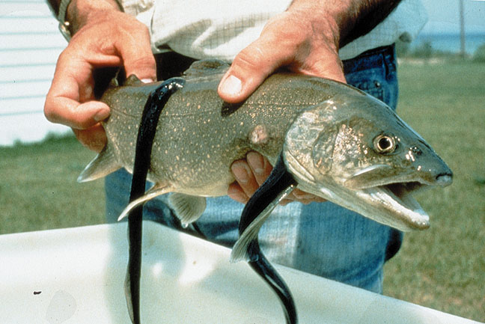
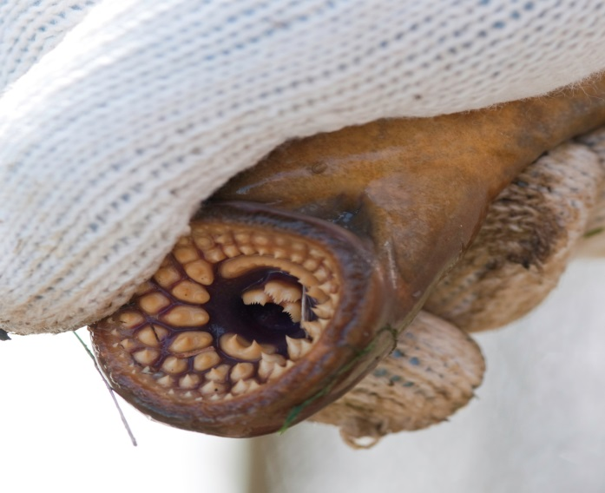
I am a Sea Lamprey (an invasive species)
I am a blood sucking parasitic fish native to the Atlantic Ocean
I invaded Lake Ontario via the Earie Canal System in the 1800’s
I target native fish species such as Atlantic Salmon and Trout, which are considered desirable sportfish.
I am controlled by lampricides (pesticides), and barriers.

Slide 9
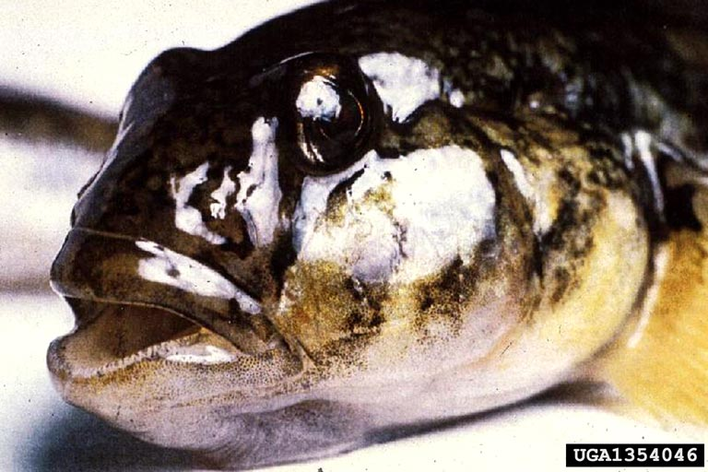
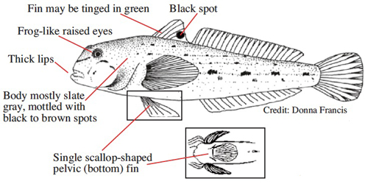
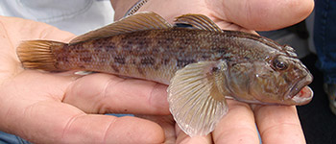
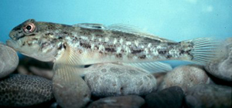
I am a Round Goby (an invasive species)
I’m from the Baltic and Caspian Sea; I arrived in Lake Ontario via ballast water of large ships through the Erie Canal.
I eat fish eggs and the small fry of native fish
I also feed on Zebra mussels and can spread diseases to fish that eat me due to this eating habit.
To prevent my spread don’t use me as bait !

Slide 10
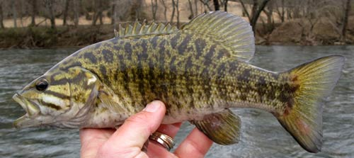
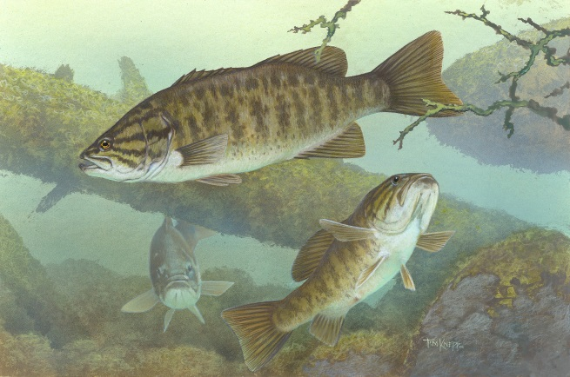
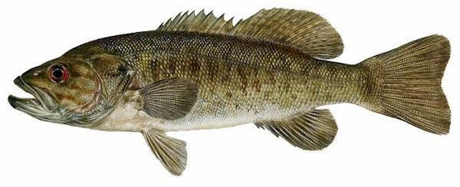
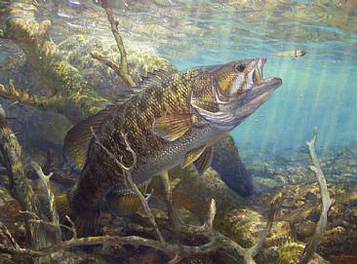
I am a smallmouth bass
I am a popular sportfish native to eastern and central North America
I am a natural indicator of a healthy environment
I am a predator species and feed on crayfish, smaller fish, and insects.
The invasive species called the round goby, eats my eggs. I can get sick if I eat round gobies.

Slide 11
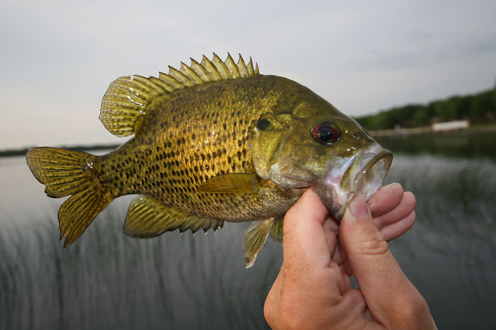
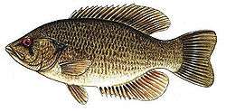
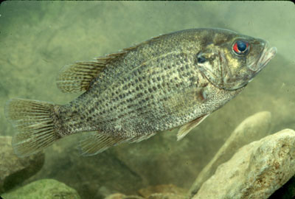
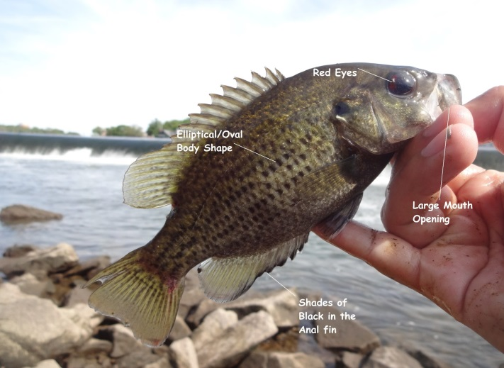
I am a rock bass
I am a popular sportfish native to eastern and central North America
I am a predator species and feed on crayfish, smaller fish, and insects.
The invasive species called the round goby, eats my eggs. I can get sick if I eat round gobies.

Slide 12
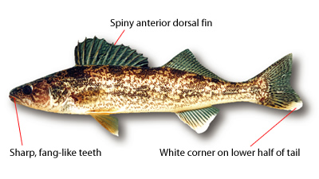
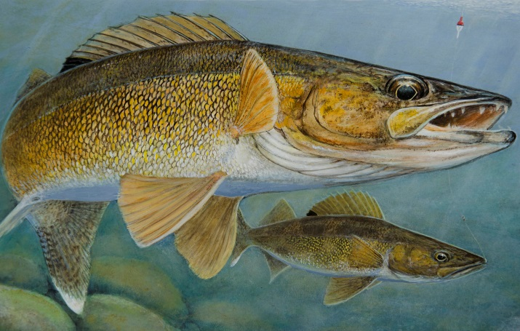
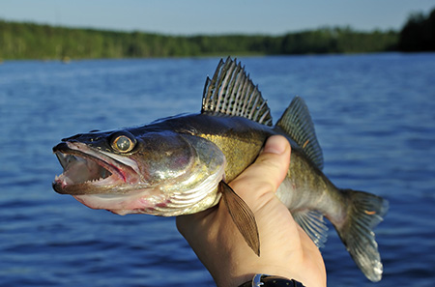
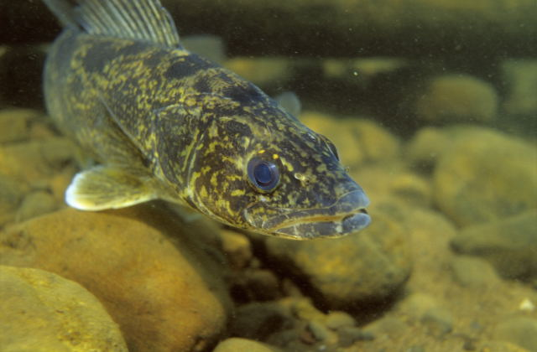
I am a walleye
I am a popular sportfish native to North America
I am a predator species and feed on crayfish, smaller fish, and insects.
The invasive species called the round goby, eats my eggs. I can get sick if I eat round gobies.

Slide 13
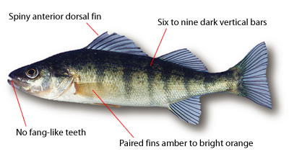
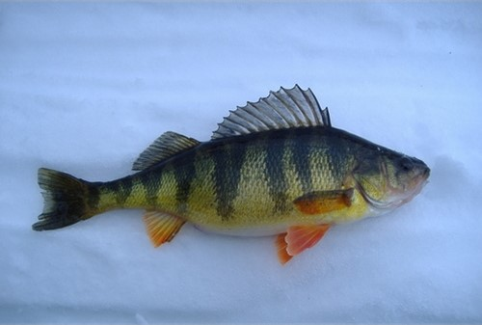
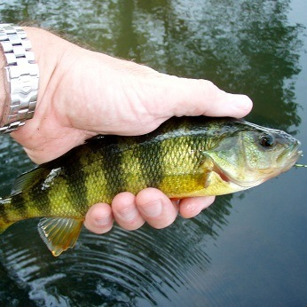
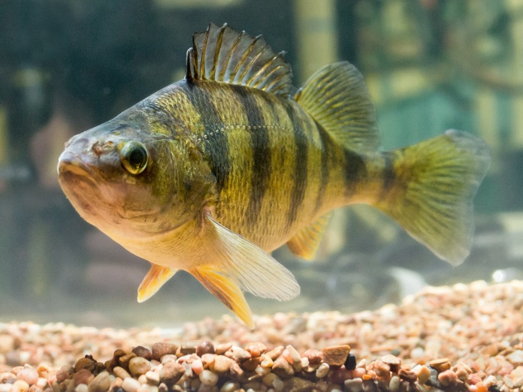
I am a yellow perch
I am a popular sportfish native to North America.
I am a predator species and feed on worms, insects and small fish.
The invasive species called the round goby, eats my eggs. I can get sick if I eat round gobies.

Slide 14
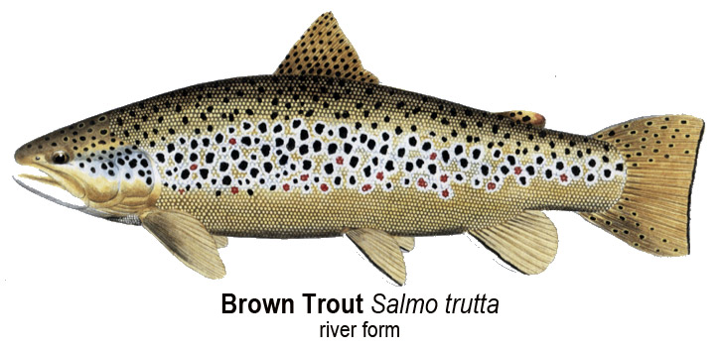
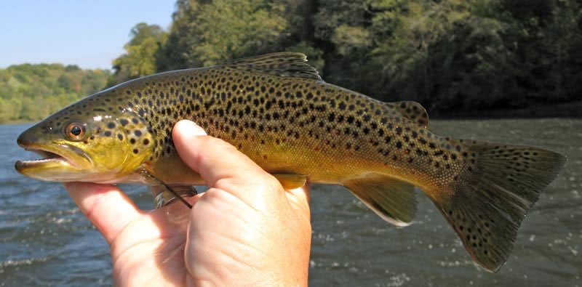
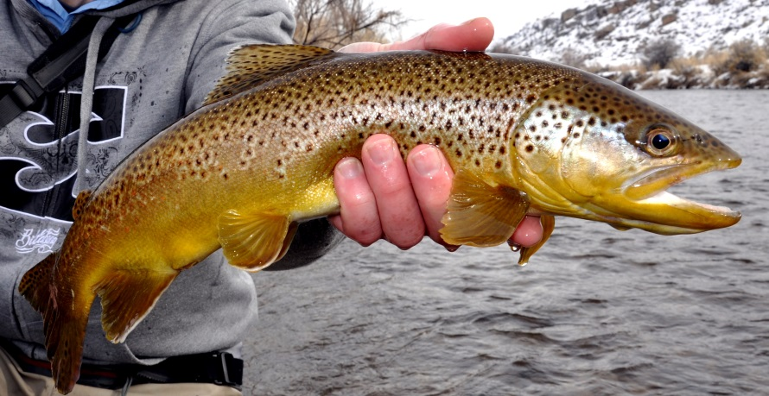
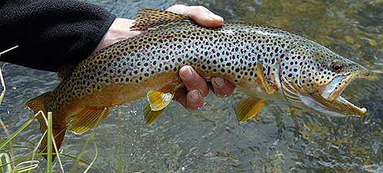
I am a brown trout
I am a popular sportfish native to North America.
I am a predator species and feed on worms, insects and small fish.
The invasive species called the round goby, eats my eggs. I can get sick if I eat round gobies.

Slide 15
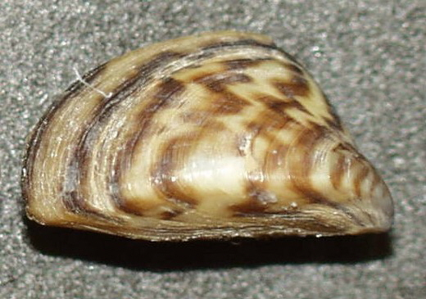
I am a Zebra Mussel (an invasive species)
I’m Native to the Baltic and Caspian Sea, and traveled to the Great Lakes via ballast water of large ships through the Erie Canal.
I feed on phyto- and zooplankton, a primary aquatic food source.
I damage boats, piping systems, and I can attach to and suffocate crustaceans and mollusks.
I can spread disease such as botulism to fish that eat me.

Slide 16
I am Purple Loosestrife (an invasive species)
I’m a herbaceous perennial wetland plant native to Eurasia.
I was intentionally introduced to North America due to my beautiful blooms.
I produce a lot of seeds in a season, up to 1 million seeds/ plant!
I take over wetland ecosystems and out-compete important wetland species such as cattails.

Slide 17
I am a cattail
I am a wetland plant that is native to North America.
I protect inland areas from storm surges.
I provide food and habitat for a variety of wildlife.
My populations are reduced by the presence of the invasive species called Purple Loosestrife.

Slide 18
I am Phytoplankton
I am an aquatic microorganism
I am a primary producer and use sunlight to make energy
I am a main food source for a wide variety of species
Zebra mussels eat me quickly, greatly reducing my population.

Slide 19
I am zooplankton
I am a form of plankton consisting of small animals and the immature stages of larger animals.
I am a main food source for a wide variety of species.
I eat phytoplankton.
Zebra mussels eat me quickly greatly reducing my population.

Slide 20
I am Phragmites (an invasive species)
I am a perennial grass that is thought to have originated from the Middle East.
I grow in inland and wetland areas such as marshes, and fens; I also like to grow along roadsides and other disturbed areas.
I out-compete important native species such as cattails, and reduce necessary habitat for wetland species such red winged blackbirds, and waterfowl (mallards, and geese).

Slide 21
I am a Red-winged Black Bird
I am a beautiful songbird native to North America.
I live in marine and freshwater wetlands and marshes.
I use cattail habitats to breed and nest.
Invasive species like Phragmites and Purple Loosestrife impact me.
Male
Female

Slide 22
I am a mallard
I am one of the most recognized duck in North America.
I live in wetland habitats as well as lakes and ponds.
I feed on seeds, rootlets and tubers of aquatic plants off swamp and river bottoms.
I use cattail stands for shelter and sometimes nesting.
Invasive species such as Phragmites and Purple Loosestrife impact me by reducing cattail habitat.

Slide 23
I am a water chestnut (an invasive species)
I am an aquatic invasive species from Eurasian waters.
I may have been introduced through the aquatic industry.
I grow in large masses that float on top of the water and develop sharp seed pods that can last for several years.
I outcompete native aquatic vegetation and reduce habitat for fish.
You can reduce my spread by cleaning, draining and drying your boat and not speeding in no current zones.

Slide 24
I am a native aquatic plant
We are native aquatic plants
We are primary producers and get our energy from the sun while increasing oxygen levels in water.
We provide food and habitat for a variety of species.
We are impacted by aquatic invasive plant species such as Water Chestnut.
Elodea
Water Lilly
Coontail
Pickerel weed

