Slide 1
Using Drones For Invasive Species Management
Josh Payette
Park Manager II
NYSOPRHP
5/19/16

Slide 2
What is a drone?
Drone
UAV-Unmanned Aerial Vehicle
UAS-Unmanned Aircraft System
All of the above refer to remotely or autonomously guided unmanned aircraft
FAA registration regulations apply only to UAS that weigh between .55 lbs and 50 lbs

Slide 3
Key Regulations
Complete regulations can be found at http://www.faa.gov/uas/
3 Categories of Operators
Model Aircraft (Edu./Rec.)
Civil Operations (Comm./Incidental to Business)
Government Operations
FAA requires registration for all of these uses for UAS falling within the weight range.
http://www.faa.gov/uas/registration/

Slide 4
Model Aircraft (Educational/Recreational) – In addition to following the small UAS rules listed below, users must obtain an FAA registration number, and must not engage in commercial activity.
Fly below 400 feet and remain clear of surrounding obstacles
Keep the aircraft within visual line of sight at all times
Remain well clear of and yield to manned aircraft operations
Don't fly within 5 miles of an airport unless you contact the airport and control tower before flying
Don't fly near people or stadiums
Don't fly an aircraft that weighs more than 55 lbs
Don't fly from a moving vehicle
Don’t fly at night

Slide 5
Civil Operations (Commercial, Incidental to Business) – This category allows businesses to provide services for profit in areas such as: *real estate *agriculture *mapping *land surveys *photography *many others
Commercial operators are subject to additional considerations
Remote Pilot Airman Certificate - To become a pilot you must be at least 16 years old and able to read, speak, write, and understand English. You must be in sound physical and mental condition to safely operate a UAS. You must also pass the initial aeronautical knowledge exam at an FAA-approved knowledge testing center, which is valid for 2 years.
Currently Certified Pilots - Must hold a pilot certificate issued under 14 CFR part 61, and have completed a flight review within the previous 24 months. Certificate holders must pass either a recurrent online training course OR recurrent knowledge test every two years. They must also complete the online training course "Part 107 small Unmanned Aircraft Systems”
Certificate Holder Exemptions – Certificate holders may apply for exemptions to the small UAS rules.

Slide 6
Government Entities (e.g. law enforcement agencies, public universities, state governments, local municipalities)
Fly under the small UAS rule – follow all rules under 14 CFR part 107, including aircraft and pilot requirements
OR
Obtain a blanket public Certificate of Waiver or Authorization (COA) – The COA permits nationwide flights in Class G airspace at or below 400 feet, self-certification of the UAS pilot, and the option to obtain emergency COAs (e-COAs) under special circumstances

Slide 7
What is currently happening?
Because drones are the “cutting edge technology” of the moment, regulations are being incrementally implemented.
There is very little information available on current research partly due to restrictions from previous regulations.
Professor Tao Tang of Buffalo State is currently utilizing a UAS to locate water chestnut in the Tonawanda creek and Erie canal.
Several PRISMs are experimenting with UAS operation and applications to ISM
NYSDEC has created a “UAS Unit”, with certified pilots and state of the art gear.
UAS are gaining acceptance as they become more common.
People are just starting to imagine/implement non-military uses.

Slide 8
The Potential Is Incredible!!!
Southwick Beach/Lakeview WMA – Beach loop

Slide 9
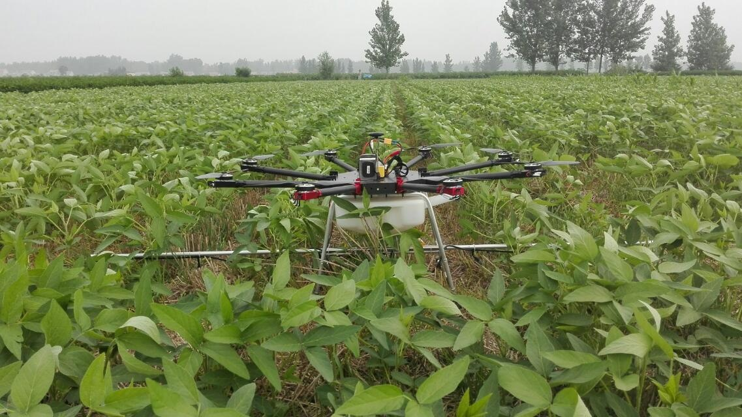
Drone Applying Pesticide Agricultural/ISM application research will undoubtedly lead to unimagined breakthroughs in the near future.
https://s.yimg.com/fz/api/res/1.2/IpzQC.kuFU__p_1QqdQ5Qg--/YXBwaWQ9c3JjaGRkO2g9NjQwO3E9OTU7dz0xMTM3/http://img.xuijs.com/nimg/7a/c7/d664ff6cba7a9af1b0dad9e3de29.jpg

Slide 10
UAS Technology Development
Multispectral Analysis (RGB, NIR, IR, FLIR)
Hi Res Cameras – 4 - 8k
GPS Flight Control
Obstacle Awareness/Avoidance
Precision Chemical Application
Intelligent Object Following
Firefighting UAS

Slide 11
Difficulties Of UAS Utilization/Operation
Weather factors can make flight planning frustrating.
When using UAS for ISM, the target species may be difficult to locate due to a large number of variables.
Difficulty navigating the ever evolving FAA, State and local regulations.
Costs associated with the hardware and software required for processing and storing large video files.

Slide 12
Processing Requirements
UHD video requires advanced processing software such as:
Adobe Premier
Cyberlink Power Director 13
Recommended System Hardware
Equivalent -Intel Core i7 2.3GHz four-core or higher
8GB of RAM, preferably 32GB
Equivalent - NVIDIA GeForce GT 750M or higher
Dedicated 7200rpm hard drive or SSD for media or preferably a RAID system.
4k display.

Slide 13
Questions? Resources:
http://www.faa.gov/uas/
http://knowbeforeyoufly.org/
https://www.youtube.com/user/FAAnews
http://www.yuneec.com/
http://www.dji.com/

