Slide 1
Ecological Studies on Extreme Drought/Climate Change and Invasive Plant Species
Eastern Lake Ontario Invasive Species Symposium
St. Lawrence Eastern Lake Ontario PRISM in cooperation with The Nature Conservancy
June 7, 2017
Steve Young, PhD
Cornell University

Slide 2
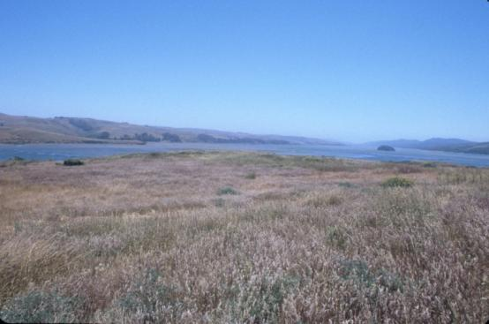
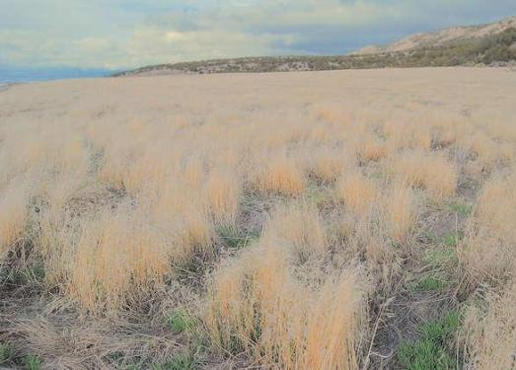
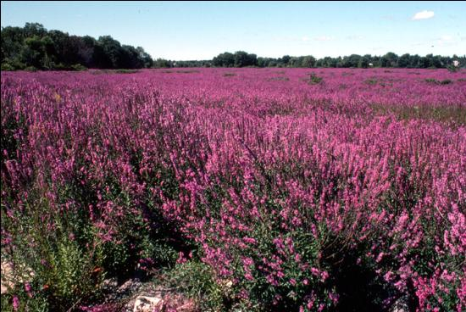
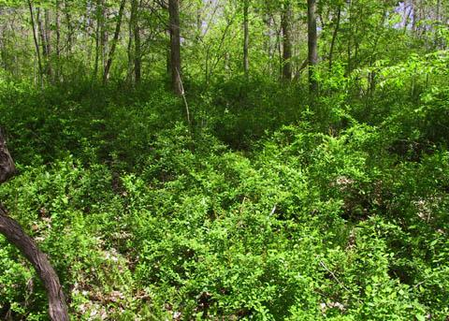
Important Plant Communities
Temperate grasslands
Semi-arid shrublands
Freshwater wetlands
Forest understories

Slide 3
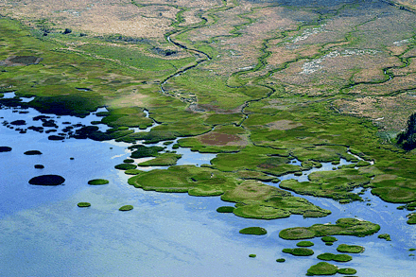
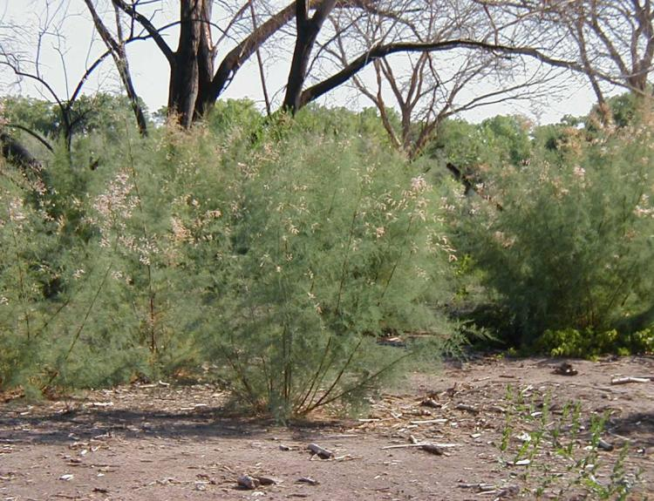
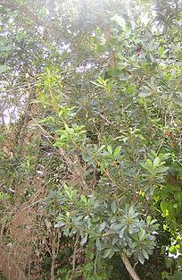
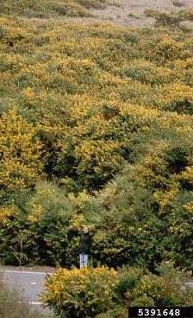
Significant Community Changes
Bromus tectorum
Spartina alterniflora
Genista
monspessulana
Tamarix spp.
Myrica faya
Notes:
Here are some examples of invasive plant monocultures in different ecosystems.

Slide 4
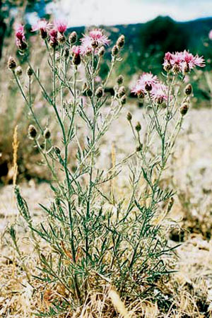
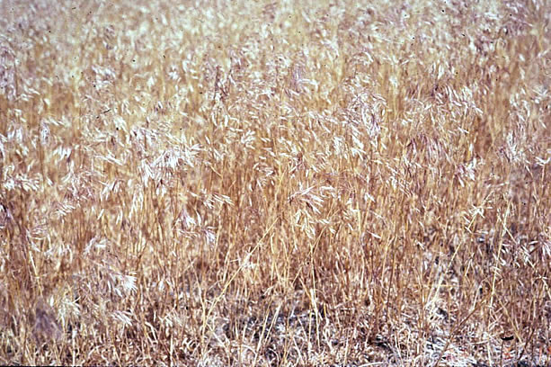
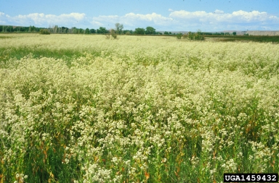
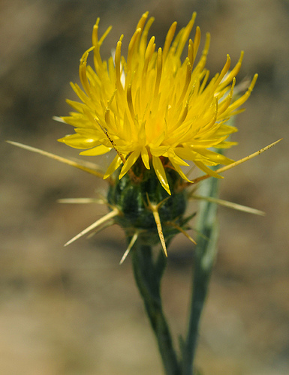
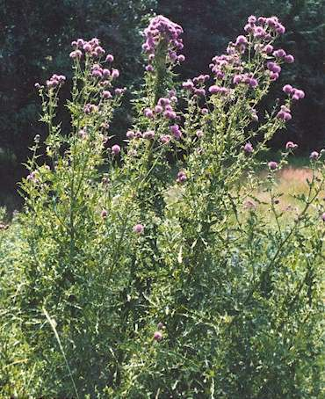
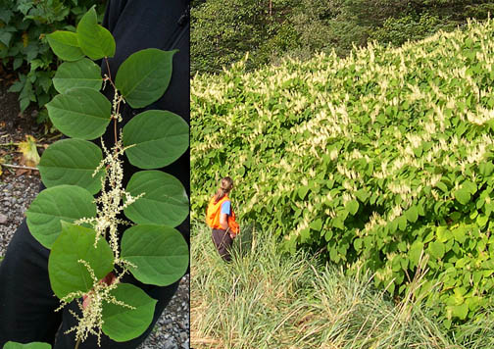
How quickly?

Slide 6
Yellow starthistle
1900
invader.dbs.umt.edu

Slide 7
Yellow starthistle
2010
invader.dbs.umt.edu

Slide 9
Perennial Pepperweed
1950
invader.dbs.umt.edu

Slide 10
Perennial Pepperweed
2010
invader.dbs.umt.edu

Slide 12
Japanese knotweed
1950
invader.dbs.umt.edu

Slide 13
Japanese knotweed
2010
invader.dbs.umt.edu

Slide 14
Invasive Plants
Survive change
Genetic alteration
Phenotypic adaptation
Resource acquisition
Alternate host facilitation
Results of change
Legacy effects
Loss of biodiversity
Cause change
Competition
Proliferation

Slide 15
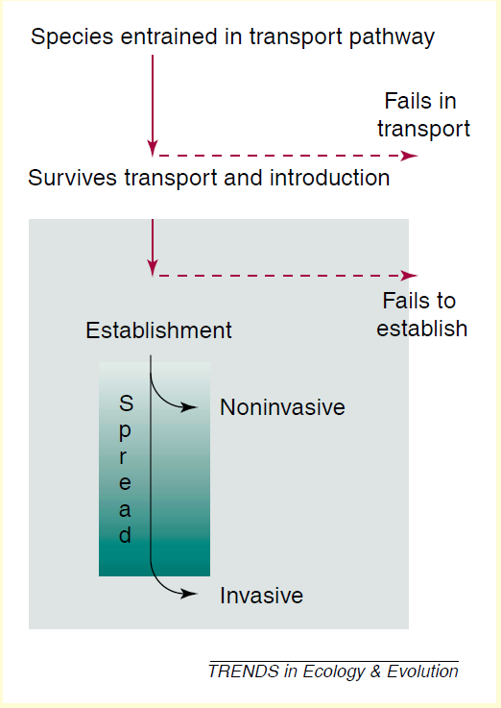
Invasive plant establishment
Genetic alteration
Phenotypic adaptation
Competition
Proliferation in changing conditions
Resource acquisition
Alternate host facilitation
Biodiversity
Kolar & Lodge (2001)

Slide 16
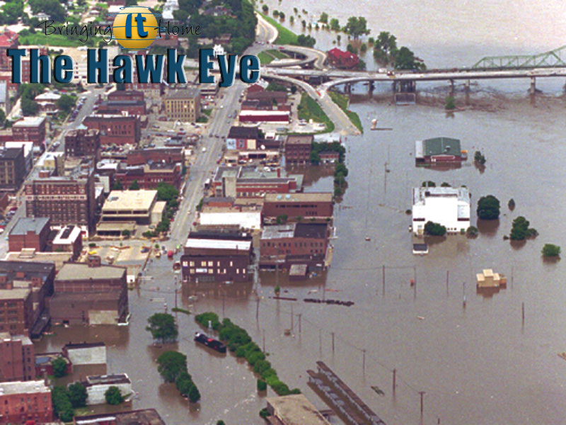
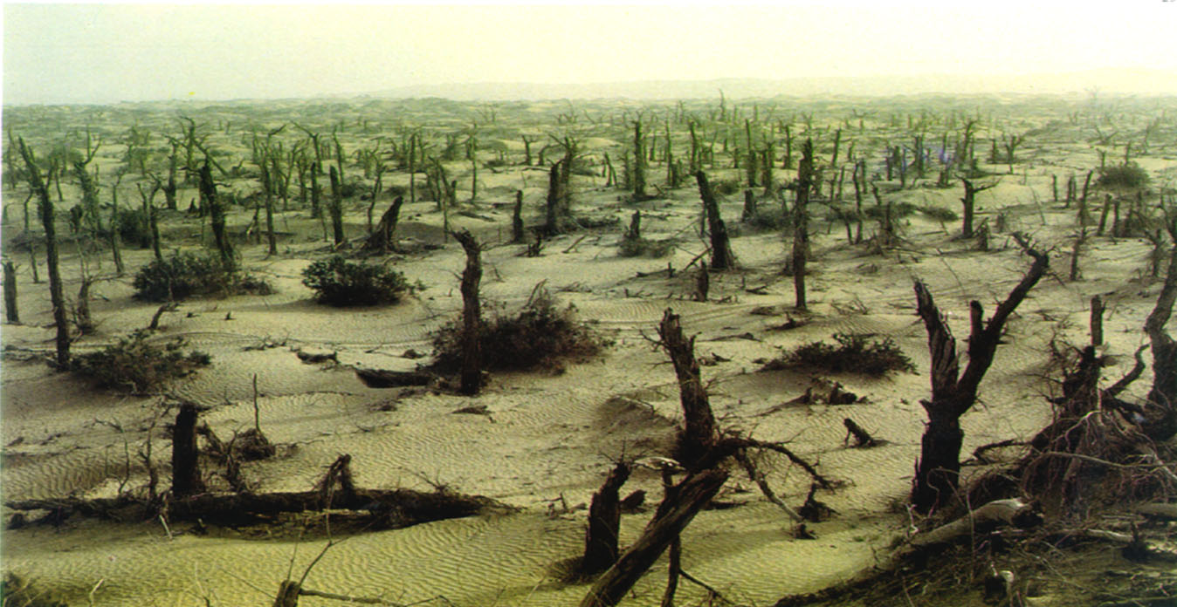
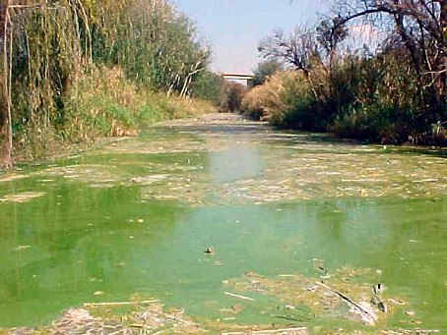
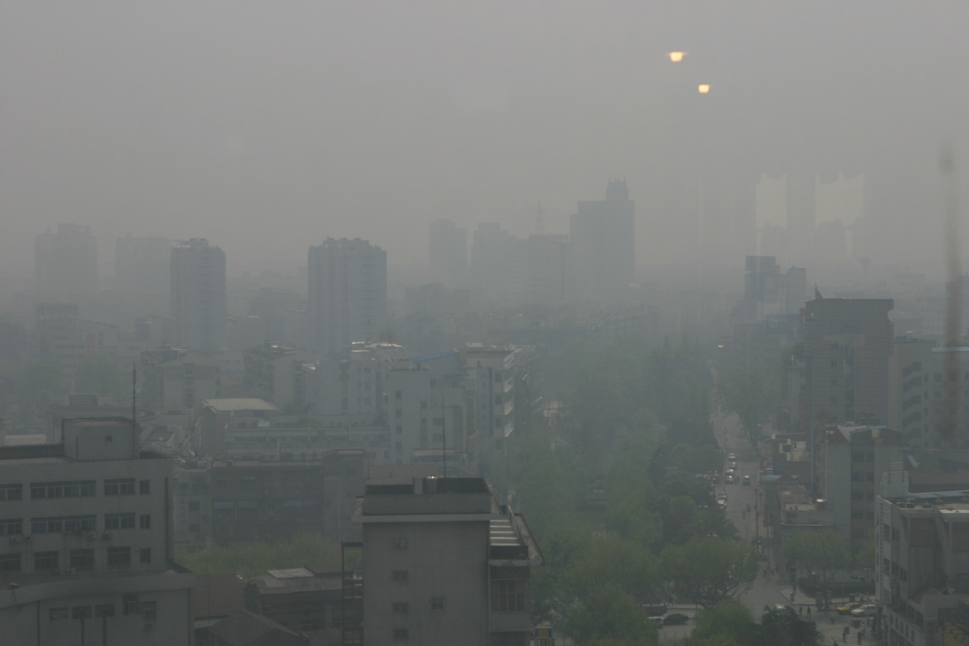
Stressed Ecosystems
Notes:
These are often taken for granted until they fail, or we overwhelm their ability to control: flooding, air pollution, water pollution, desertification
When these fail utterly, is very obvious

Slide 17
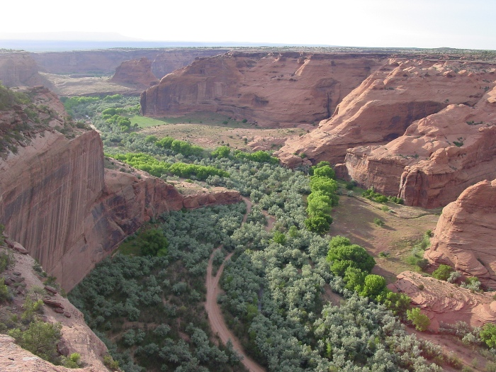
Ecosystem under stress?
Colorado River, USA
Notes:
Does this look like an ecosystem under stress? It’s hard to assess more subtle impacts on ecosystems, or predict the breaking point before a system changes to something less desirable or irreversible.

Slide 18
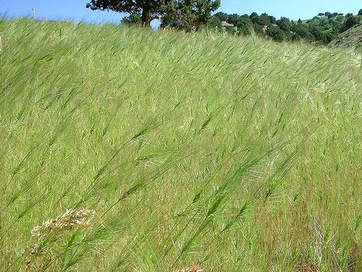
Ecosystem under stress?
Notes:
Does this look like an ecosystem under stress? It’s hard to assess more subtle impacts on ecosystems, or predict the breaking point before a system changes to something less desirable or irreversible.

Slide 19
Invasive Plant Management
Goal: Develop ”better” management practices
What type of practices – short-term, long-term, sustainable, low-input, high intensity?
If sustainable and long-term, then what do we need to know?

Slide 20
Invasive Plant Management
Goal: Develop sustainable management practices
Need to know the mechanisms
How and why invasive plants exist
Where invasive plants exist
The conditions in which invasive plants exist

Slide 21
Case Study: Invasive Plants and Extreme Drought
Riparian areas – Phragmites australis
Pasture/rangelands – Carduus nutans

Slide 22
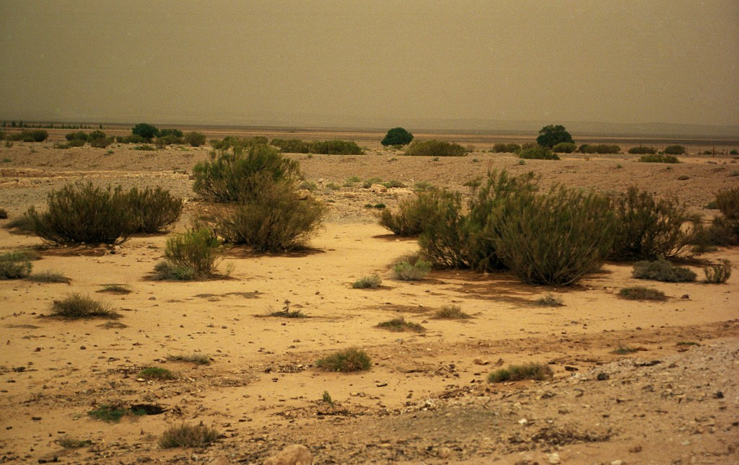
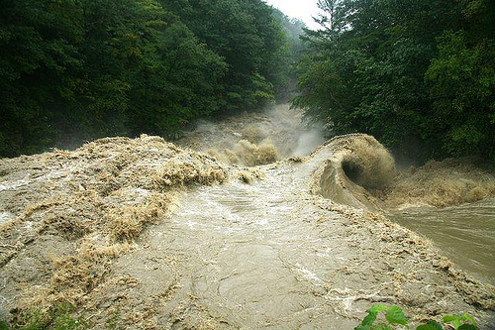
Central Great Plains Hydrology
Historical
Rise and fall of rivers
Periodic drought and flooding
Unpredictable in pre-settlement

Slide 23
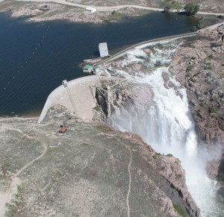
Central Great Plains Hydrology
Present day
Irrigation
Flood control
Impacts
Agriculture – food, feed, fiber production
Urban/cities – protection and supplies
Natural areas – altered species diversity and plant communities
Pathfinder Dam, Wyoming

Slide 24
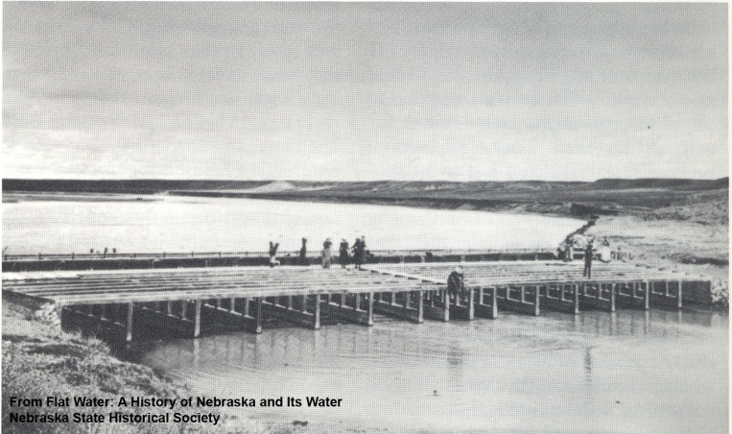
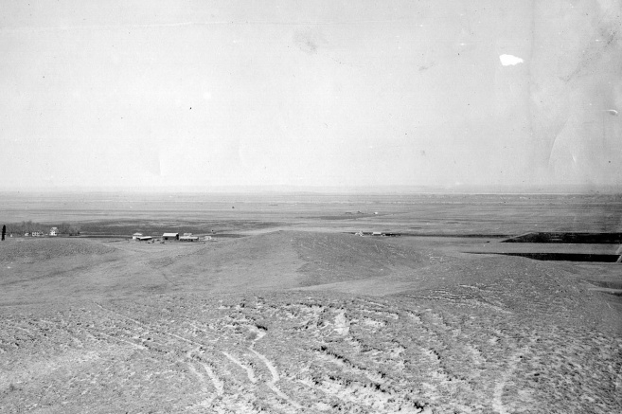
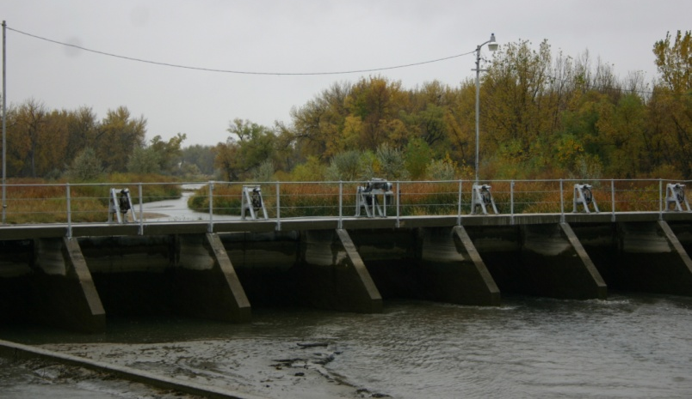
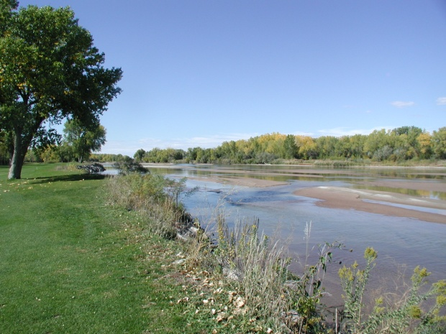
Hydrology of the Central Great Plains
1920
1905
2010
2010

Slide 25
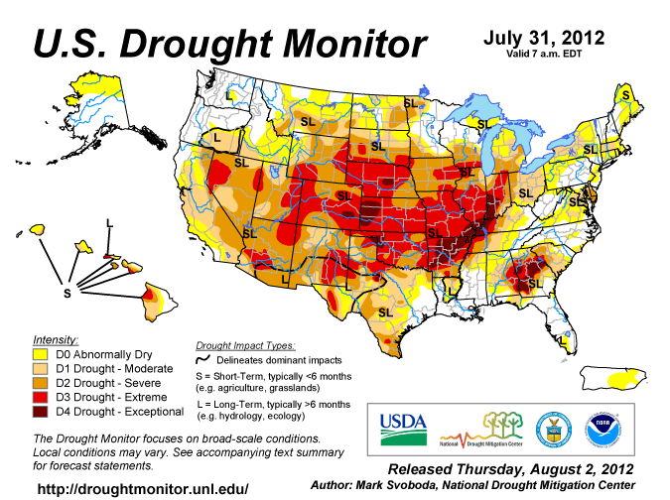
Notes:
The rise in extreme events

Slide 26
Think it couldn’t happen in NY?
Notes:
The rise in extreme events

Slide 27
September 27, 2016
Notes:
The rise in extreme events

Slide 28
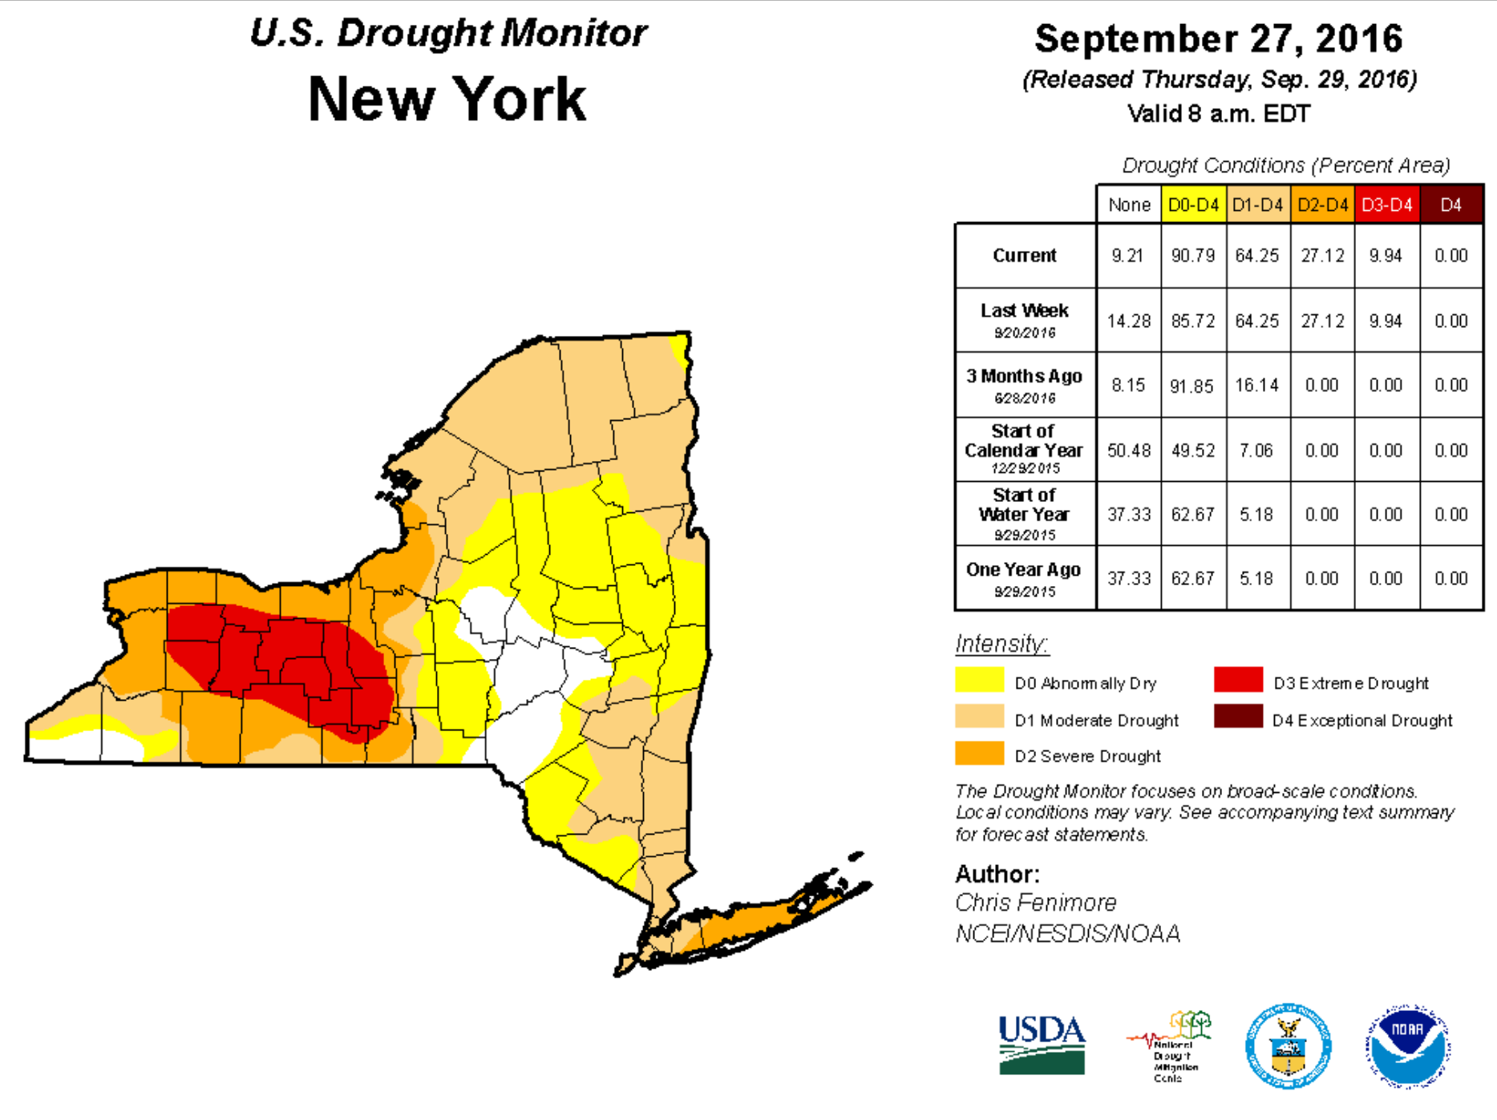
Is this a trend?

Slide 29
Objectives
Determine the response of Phragmites australis to induced drought conditions
Determine musk thistle establishment in disturbed perennial grass stands

Slide 30
Phragmites australis (non-native or introduced common reed)
Widely distributed in North America (1880s)
Robust perennial grass (>6 m tall)
Characterized by clonal growth via stolons and rhizomes (>20m long)
Reproduces sexually (seed) and vegetatively

Slide 31
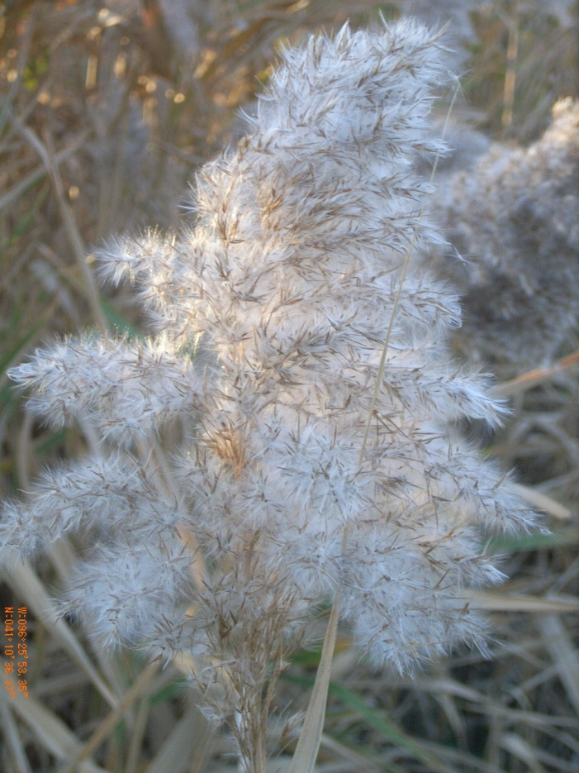
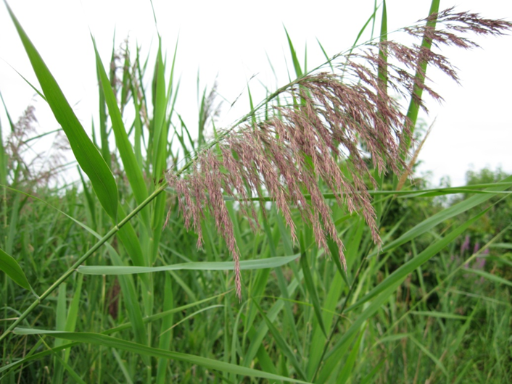
Mechanisms for survival and spread
Extensive underground rhizomes
Stomatal pore distribution
High leaf area index
Saltonstall et al., 2007; Saltonstall & Stevenson, 2007; Meyerson et al., 2009

Slide 32
Greenhouse experiments
Treatments
Low stress:
19 days
4 days >80% AWD
Medium stress:
36 days
20 days >80% AWD
Severe stress:
58 days
44 days >80% AWD
AWD = available water depleted

Slide 33
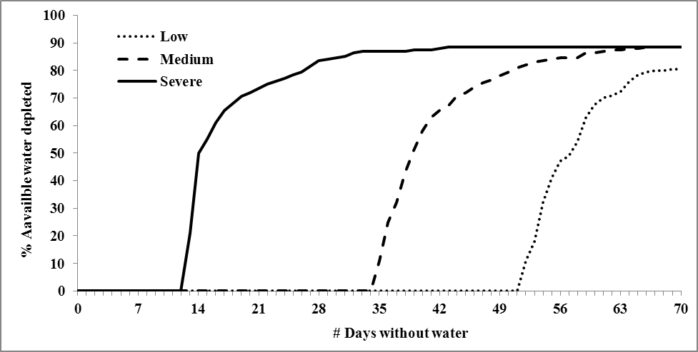
Drought regimes

Slide 34
Phragmites growth
Cover (%)
a
a
a
b
b
bcd
c
c
d
d
d
d
d
d
d
Drought
Post drought

Slide 35
Phragmites growth
Biomass (g)
a
b
b
bc
bc
c
Drought
Post drought

Slide 36
Phragmites growth (post-drought)
Height (cm)
a
ab
ab
ab
bc
cd
d
cd
e

Slide 37
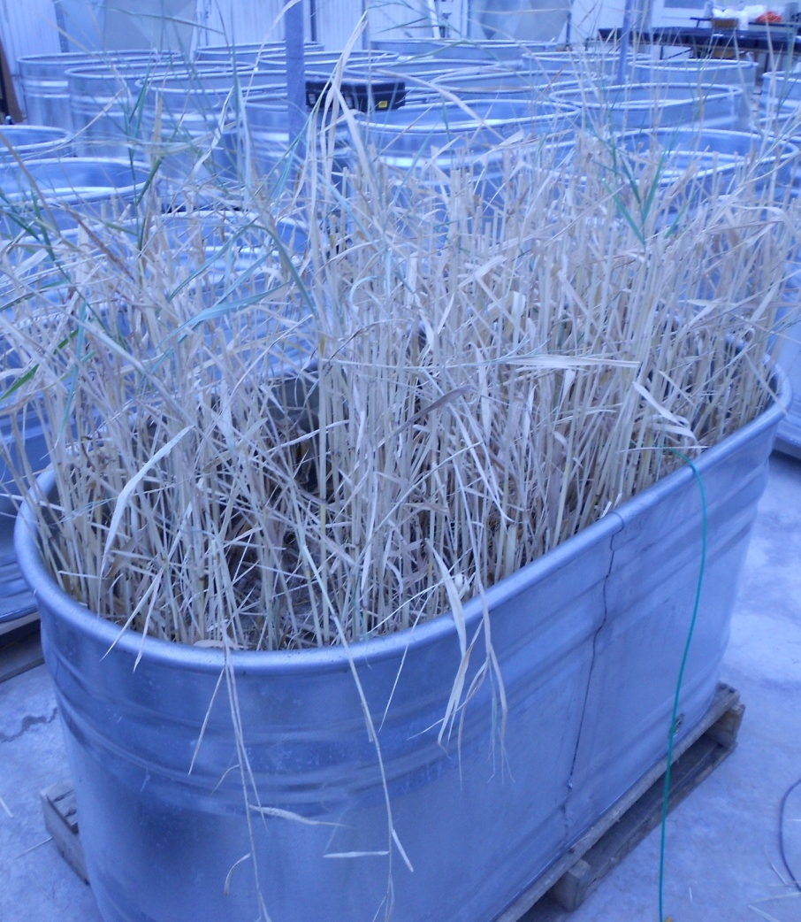
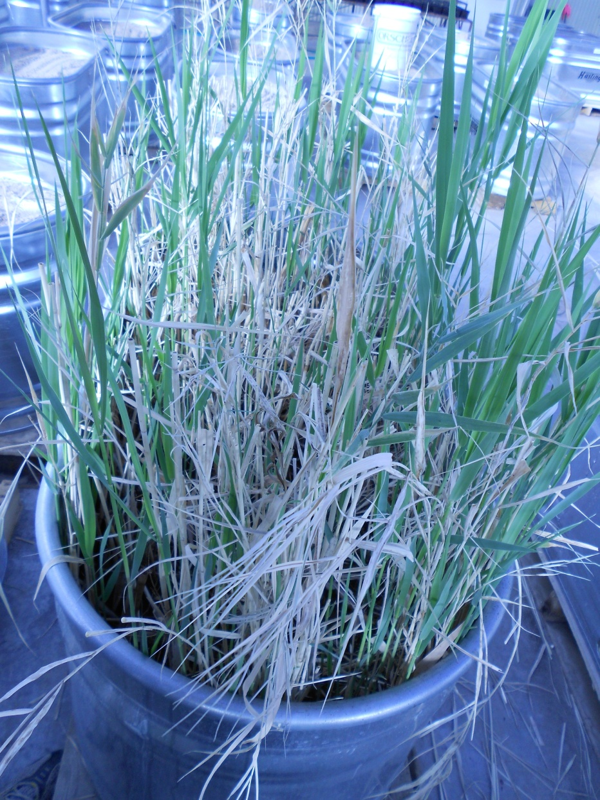
Low stress
Day 70
Low stress
Day 25 post-drought

Slide 38
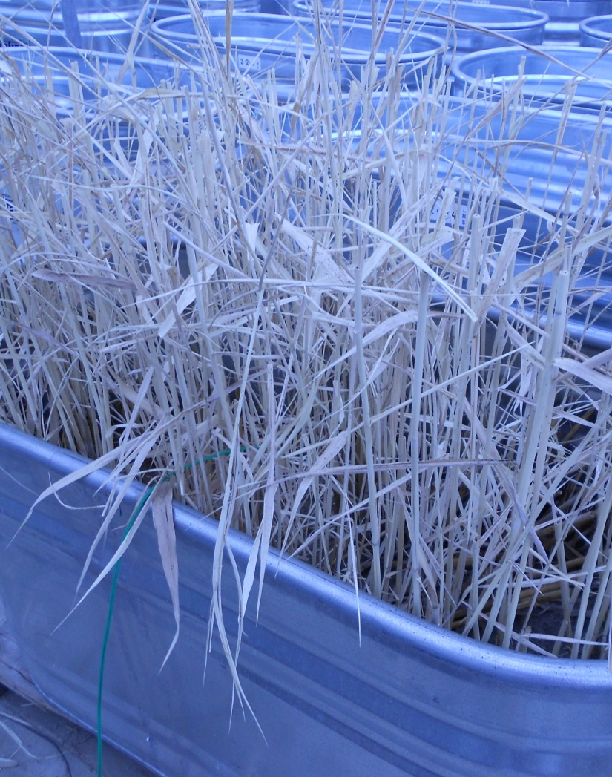
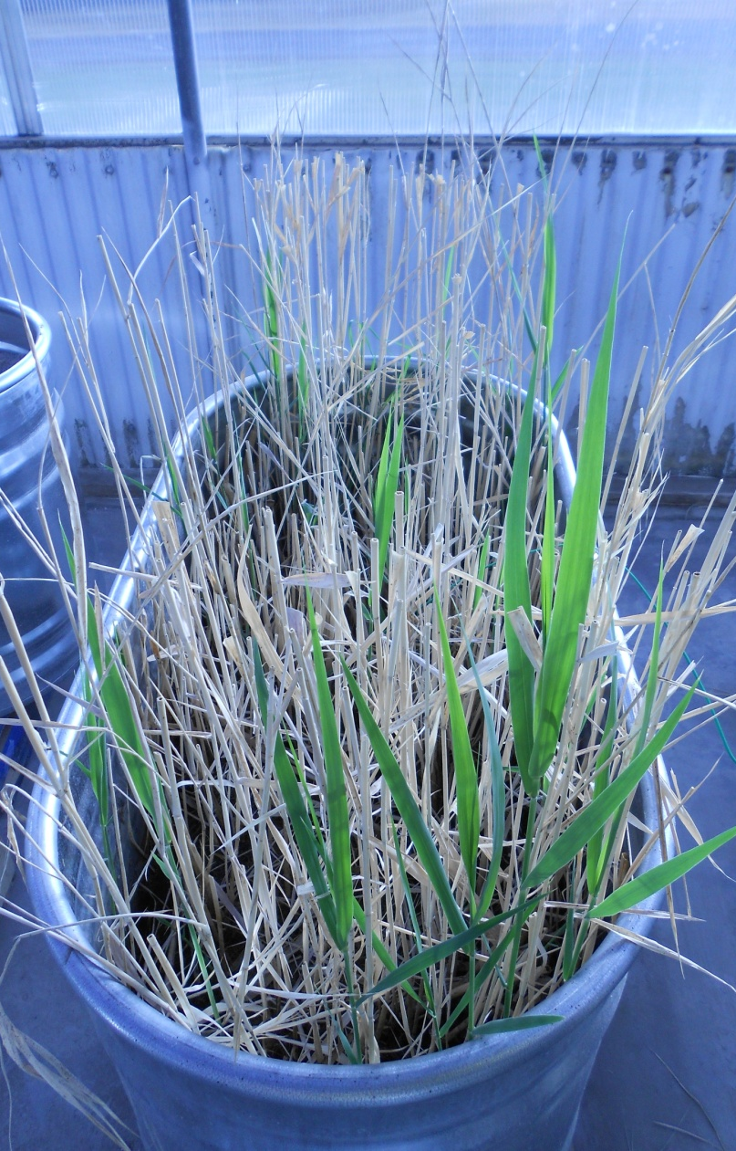
Severe stress
Day 70
Severe stress
Day 25 post-drought

Slide 39
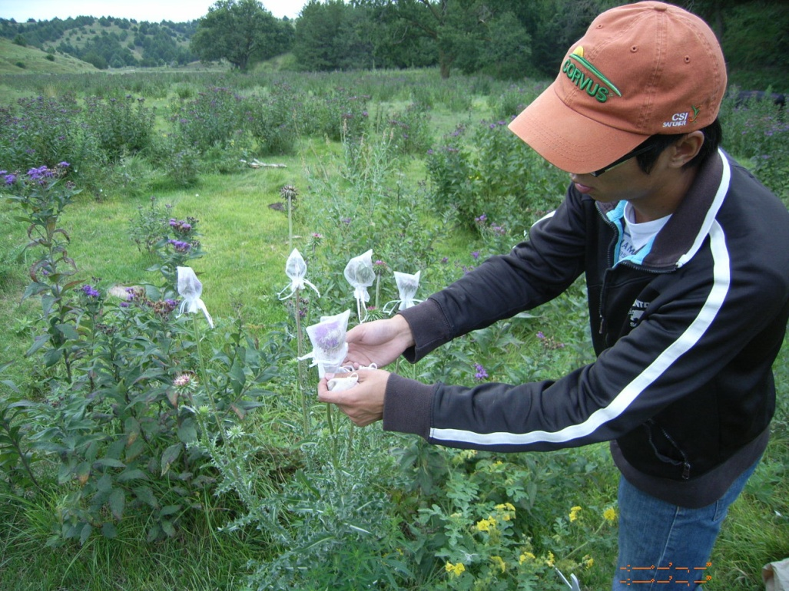
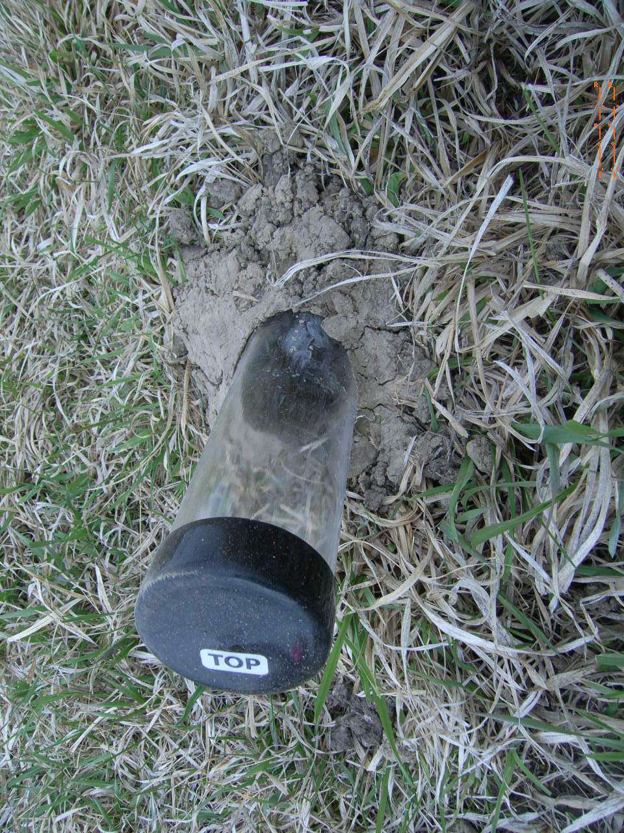
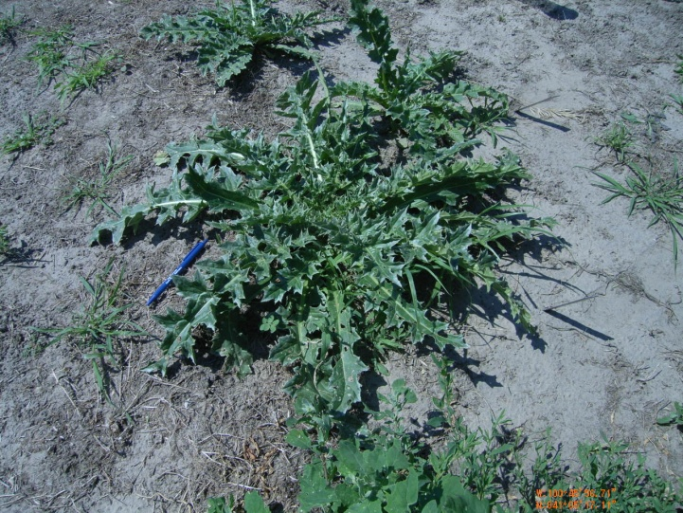
Carduus nutans (Musk thistle)
Growth habit:
Biennial?
Prolific flowering?
Establishes easily?

Slide 40
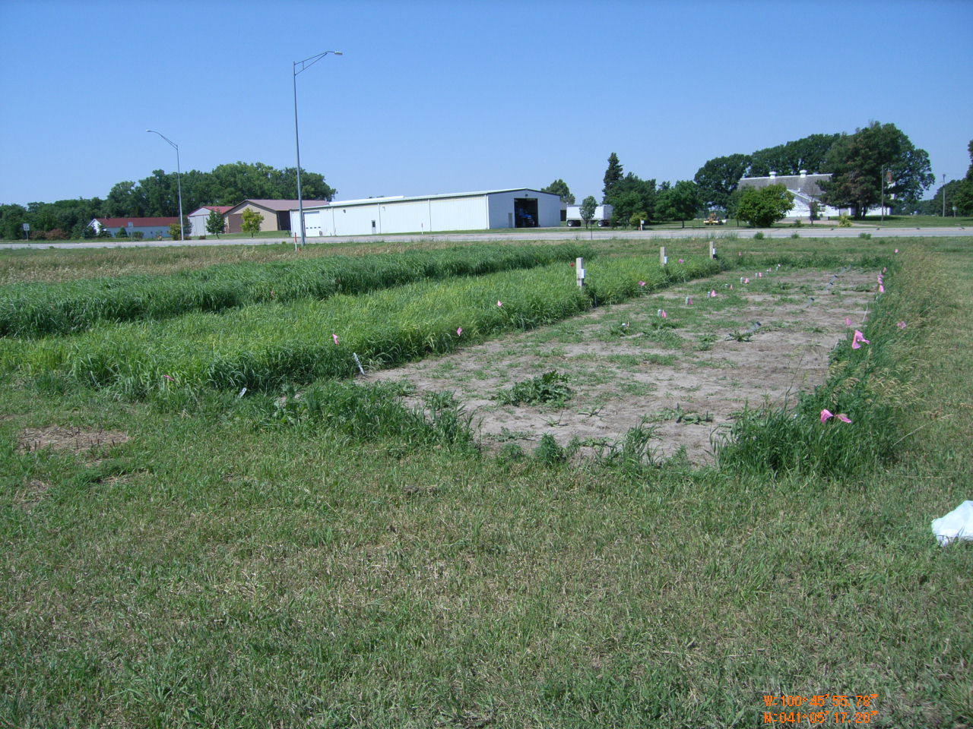
2-Year Field Experiment
Treatments
Cool- and warm-season perennial grasses
Simulated grazing for two years
Precip. – normal in 2011 and drought in 2012
Introduced musk thistle (April 2011)

Slide 41
Plant Phenology
2011 (Normal Precipitation)
2012 (Extreme Drought)
Cool Season Grasses
Warm Season Grasses
Musk Thistle

Slide 42
Results – Light penetration

Slide 43
Results – Musk thistle populations
Interaction of light and soil moisture
2011 (Normal Precipitation)
2012 (Extreme Drought)
Grazing
None

Slide 44
Results – Musk thistle cover
2011 (Normal Precipitation)
2012 (Extreme Drought)
Grazing
None

Slide 45
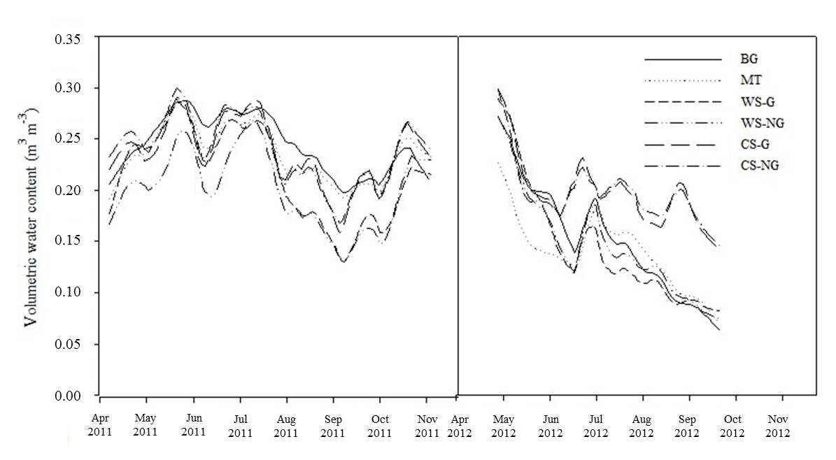
Results – Soil moisture (0-10 cm)

Slide 46
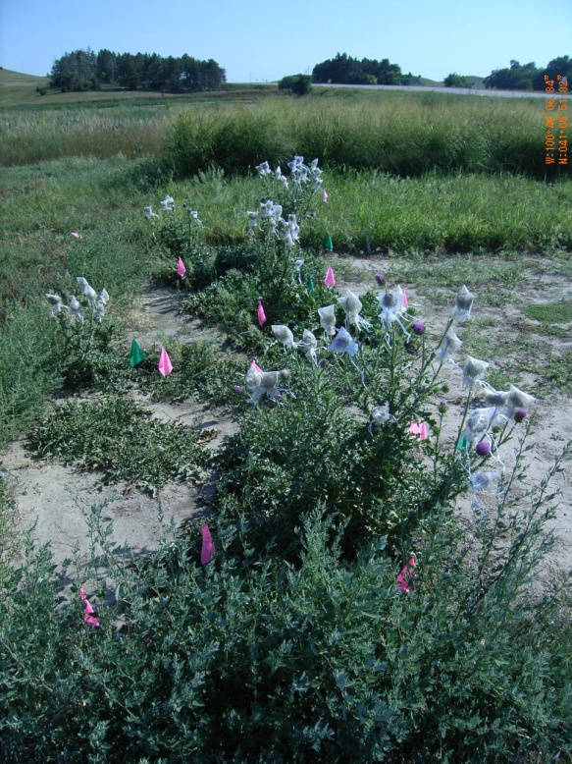
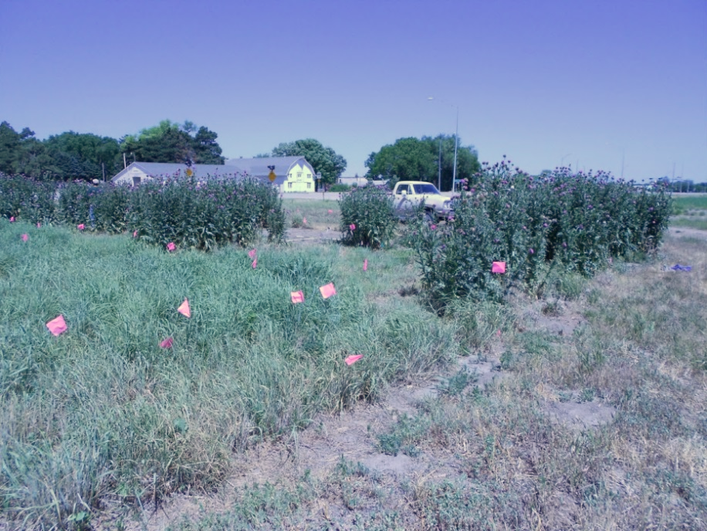
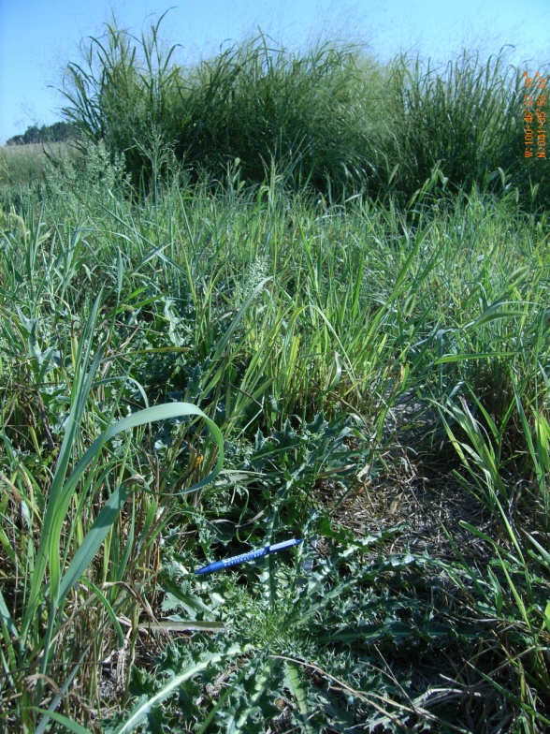
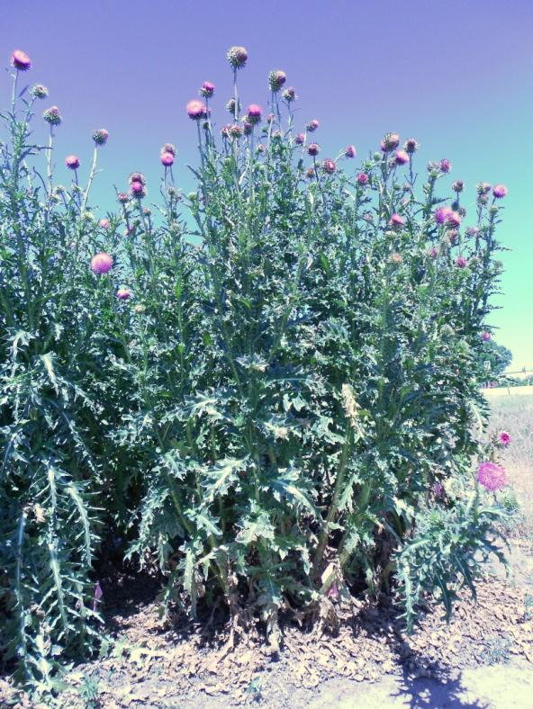
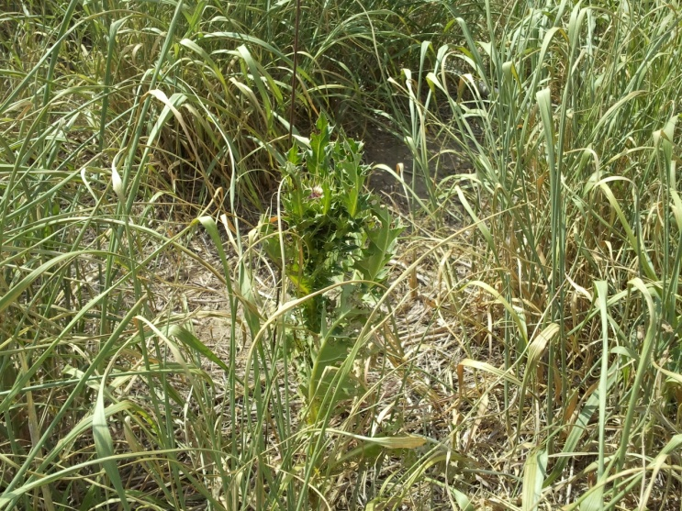
Musk thistle (Carduus nutans)
July 2012
August 2011
July 2012
Non-grazed
July 2012
Bare ground
Notes:
Musk thistle growth plasticity depends on 1) neighboring competition and 2) availability of resources. Some plants are fully mature after 5 months, while others take longer (16-18 months).

Slide 47
Research Summary
Phragmites
Following removal of water stress treatments:
Medium stressed (36 days of drought) plants had the greatest re-growth compared low (19 days) and high (58 days) stressed plants
Plant cover increased 10 fold in the medium and high stressed plants
Musk thistle
Establishment in perennial grass stands
With adequate moisture, light is required (e.g., grazing impacts)
During drought, water is the limiting factor, but grazing could lead to long-term problems

Slide 48
Further…....
So, what?
Is this a physiological response (e.g., plasticity) or could continuous extreme drought be a selection pressure for plants with genes tolerant to drought?
What do extended periods of drought mean for managing invasive plant species in riparian areas and rangelands?

Slide 49
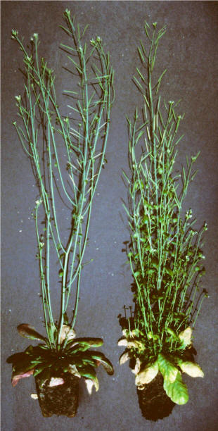
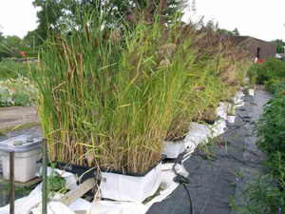
Future Research (another time)
Plant Plasticity – ability of plants to change in response to the environment
Phenotypic
Temporary
Genetic
Permanent
Notes:
Genome plasticity: A change in genome structure or organization associated with environmental signals, leading to the evolution of new phenotypes, might result from mutational hotspots, genome expansion, transposable elements or somatic recombination.
Genotype: When we refer to a genotype we do so in a population genetic sense, not in reference to a molecular sequence of a single gene, but to the complete genome.
Phenotype: The appearance or characteristics of an organism resulting from both genetic and environmental influences. In our terms, all organisms have a phenotype not just those expressing a mutation in a given gene of interest.
Phenotypic plasticity: The range of phenotypes a single genotype can express as a function of its environment.

Slide 50
Further…...
So, what?
Is this a physiological response (e.g., plasticity) or could continuous extreme drought be a selection pressure for plants with genes tolerant to drought?
What do extended periods of drought mean for management of invasive plant species?

Slide 51
What will ‘work’ in drought?
Grassland management
High richness (HR) and high density (HD)?
“Neither HR nor HD treatments produced plant communities with superior drought resistance, recovery, or resilience” (Carter & Blair, 2012)
Management option: greater native species with DT traits and (hope for) 1-year drought
Establishing certain plant groups?
“Maintaining the number of grams of biomass produced (i.e., productivity) is what matters most for repelling Centaurea maculosa (spotted knapweed) invasions” (Rinella et al., 2007)
Management option: maintain grass growth or risk invasives accessing unused resources

Slide 52
What will ‘work’ in drought?
Grassland management (cont.)
Cool- or warm-season perennial grasses?
“During a drought year, warm- and cool-season perennial grasses are able to out compete musk thistle, unless a WS community is excessively grazed in the year prior to the drought.” (Han & Young, 2016)
Management option: In drought years, less frequent or no grazing to prevent establishment of a few musk thistle plants leading to higher populations in later years with normal precipitation

Slide 53
What will ‘work’ in drought?
Wetland management
Control the flow of river systems?
“Using environmental flows to limit the spread of invasive plants by targeting a life-stage that is particularly sensitive to prolonged submergence. However, there may be narrow thresholds between the conditions that provide effective control of an invasive species, and those that instead facilitate growth and may promote further invasion.” (Vivian et al. 2014)
Management option: Drought has little effect on Phragmites; longer-term control requires a combination of mechanical and chemical treatments; revegetation with desirable species is an additional option (Rapp et al. 2012)

Slide 54
Thanks!

