Slide 1
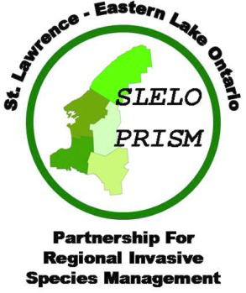
Saint Lawrence
Eastern Lake Ontario
Partnership for Regional Invasive Species Management
SLELO - PRISM

Slide 2

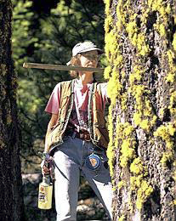
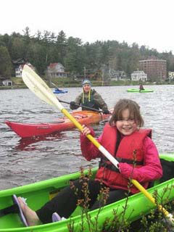
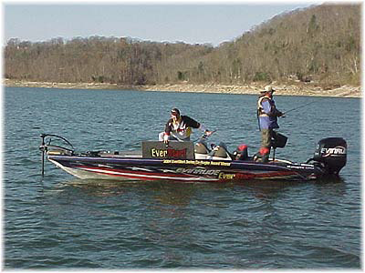
What is a PRISM?
A regional partnership of diverse stakeholders formed to address the threat of invasive species in a cooperative, comprehensive, cost‐effective way across a designated geographical area.

Slide 3
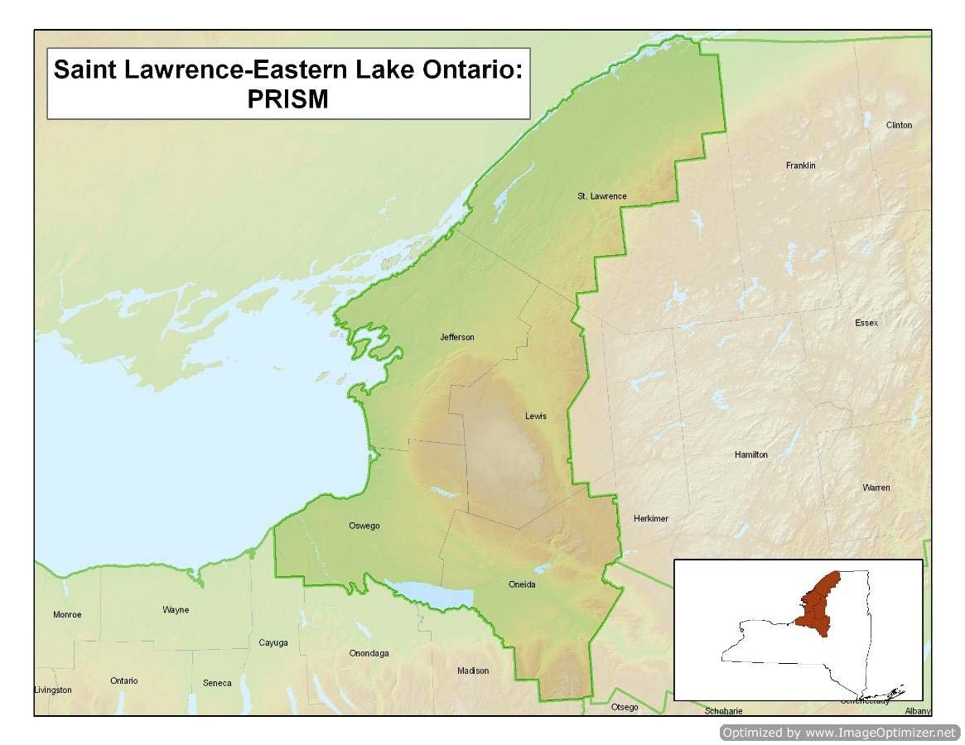

Slide 4
How SLELO came to be…
  Mid‐late 1990’s Cooperative Weed Management Area focused on pale swallow‐wort in Jefferson County. Worked with landowners, especially tree farmers to locate, map and control invasive species.
2000’s increased partnership work on Tug Hill and
eastern Lake Ontario.
2007 TNC selected as the host organization by
partners in part due to lack of organizational
capacity in region.
In 2011, hired an Invasive Species Program Coordinator for the
SLELO program.

Slide 5
Our mission:
To protect the natural and cultural integrity of aquatic and terrestrial areas in Jefferson, Oswego, Oneida, St. Lawrence, and Lewis counties from invasive species.

Slide 6
Partners:
NYS dept. of Transportation
NYS Dept. of Environmental Conservation
NYS Parks, Recreation & Historic Preservation
The Nature Conservancy
USDA
Cornell Cooperative Extension
Soil & Water Conservation Districts
Ducks Unlimited
Lake Bonaparte Conservation Club
NYS Sea Grant
Tug Hill Commission
Tug Hill Tomorrow Land Trust
Fort Drum Military Installation
NY Natural Heritage Program
Save The River Org.

Slide 7
PRISM Core Functions
  Coordination (among partners)
  Planning (strategic planning & Annual Op’s Planning– Develop Areas of Concern AOC’s , etc)
  Volunteers (recruit & train)
  Education (identify educational opportunities & meet needs)
  Early Detection (monitoring network, seasonal assessments)
  Rapid Response (pilots)
  Eradication / Suppression (implement field level projects)
  Research (citizen science)

Slide 8
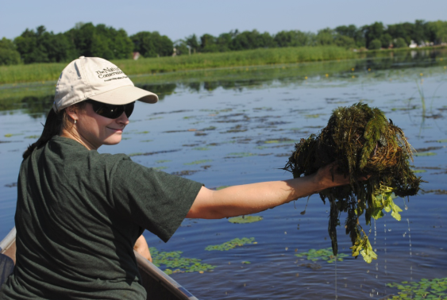
Next Steps & Processes
Reunite partners & interested
organizations - Fall 2011.
Develop Strategic Plan – general ( fall-
winter 2011-12).
Develop Annual Plan – specifics (fall/winter
2011-12).
Coordinate field projects and
activities that support our mission (spring,
summer, fall 2012 & beyond.

Slide 9
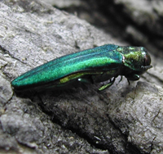
Impacts of Invasive Species (plant, animal, insect)
On a global basis, invasive species are second only to habitat destruction as the greatest threat to native plants, animals and natural communities, such as forests, wetlands, streams, and ponds. In fact, experts estimate that invasive species have contributed to the population decline of 42% of threatened and endangered species in the U.S.
Many invasives also pose threats to agricultural areas, urban parks, yards, and roadsides. Some invasive species, such as West Nile virus, hydrilla, zebra mussel, and emerald ash borer, prey upon, displace or otherwise harm native species.
Others compete directly with native species for nutrients, sunlight and space.
Invasive species can also alter ecosystem processes, transport disease, interfere with crop production, and cause disease in animals or humans. Invasive plants are often less valuable to animals for food and shelter, so they can reduce wildlife populations.

Slide 10
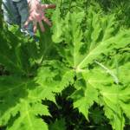
Impacts of Invasive Species, cont…
Invasive species are a leading source of environmental and economic damage across New York State. Recent estimates conclude that invasive species cost the U.S. at least $137 billion per year.
In addition to reducing the diversity of native plants and animals, invasive species have the potential to impact forest regeneration, agriculture, and recreation.
Garlic mustard, for example, has been shown to reduce the viability of tree seedlings by exuding a toxic chemical into the soil.
Japanese knotweed grows in dense patches along streams, which can alter stream habitat conditions and make fishing access difficult if not impossible.
Contact with giant hogweed can have serious health consequences.
End of Part I

Slide 11
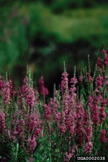
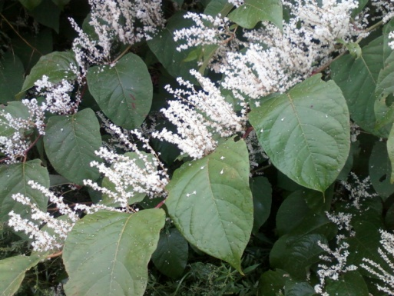
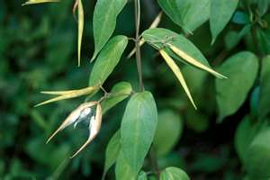
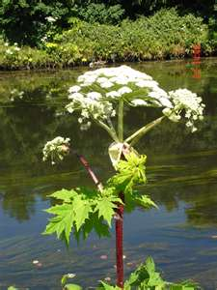
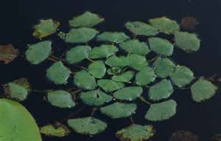
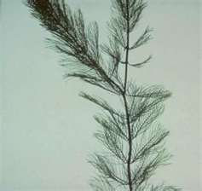
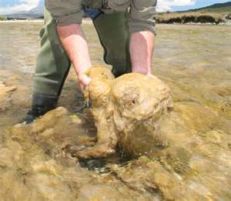
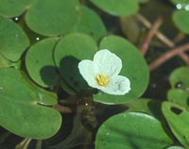
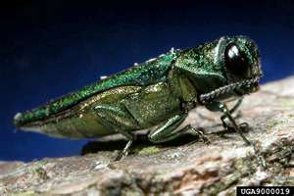
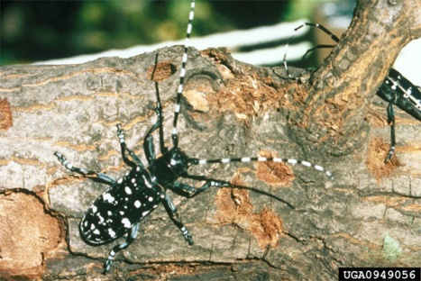
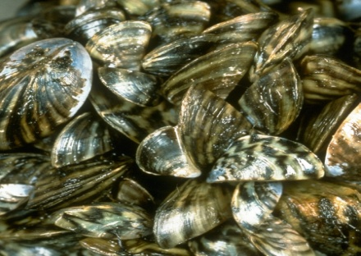
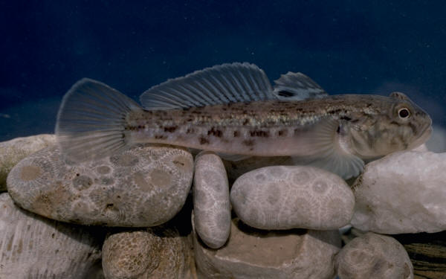
Examples of Invasive Species
Japanese Knotweed
Swallow-Wart
Giant Hogweed
Purple Loosestrife
Didymo
Water Chestnut
Eurasian Water Milfoil
Frog’s Bit
Emerald Ash Borer
Asian Long-horned Beetle
Zebra Muscle
Round Goby

Slide 12
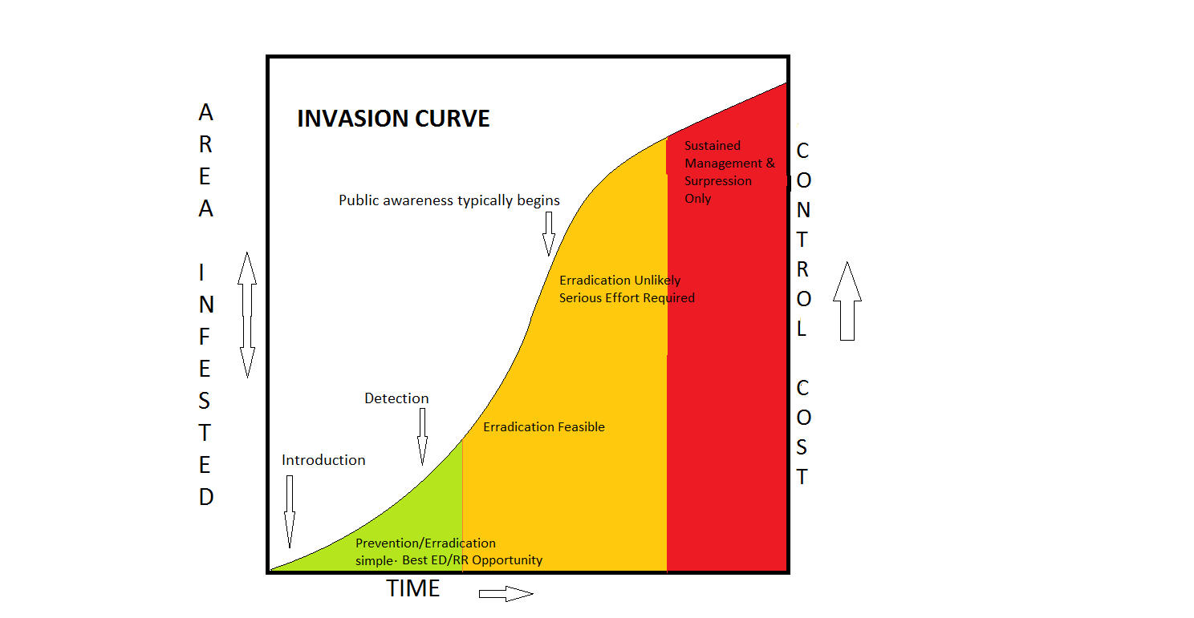
Part II
Controlling Invasive Species

Slide 13
Controlling Invasive Aquatic & Terrestrial Plants
Categories:
Education, public education on invasive spp.
Prevention – Support transport regulations.
Early detection / rapid response.
Physical – Hand pulling, pod pulls.
Mechanical – Mech.Aquatic plant harvesters, mowers, eg. Bush-hogs!
Barriers – Benthic Barriers.
Chemical – Aquatic & terrestrial herbicides.
Biological – insects.
Fire – controlled burn and/or firelines.

Slide 14
Education
The more people know about invasive species, the more we can all contribute to prevention & management.
The SLELO-PRISM sponsors training workshops for volunteers, interns and other interested organizations or groups.

Slide 15
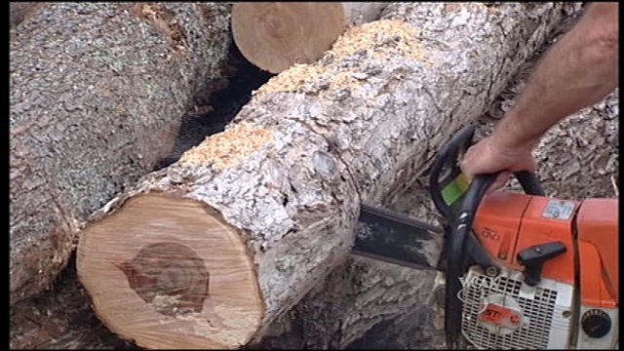
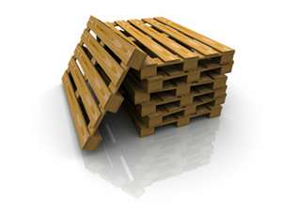
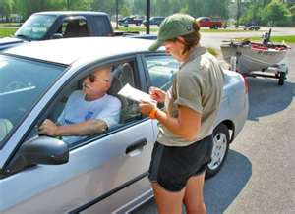

Prevention
Support transport regulations such as
    firewood laws
    heat-treated shipping pallets
    Launch ramp stewardship
    Local ordinances

Slide 16
Early Detection / Rapid Response
Trained volunteers can act as an early detection team by spotting and reporting invasive species.
Trained volunteers, interns, seasonal employees and contractors can respond quickly and efficiently to neutralize the establishment or spread of the target species.

Slide 17
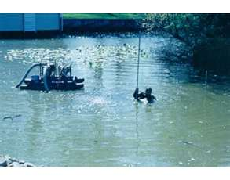
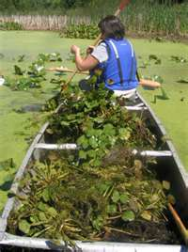
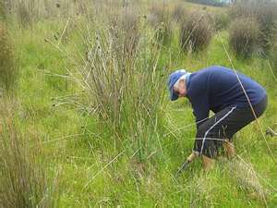
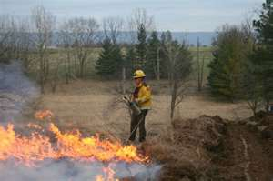
Physical Control Methods
Hand Pulling
Digging & Dredging
Pod Pulls
Controlled burns/firelines

Slide 18
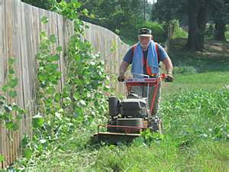
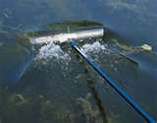
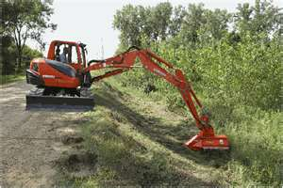
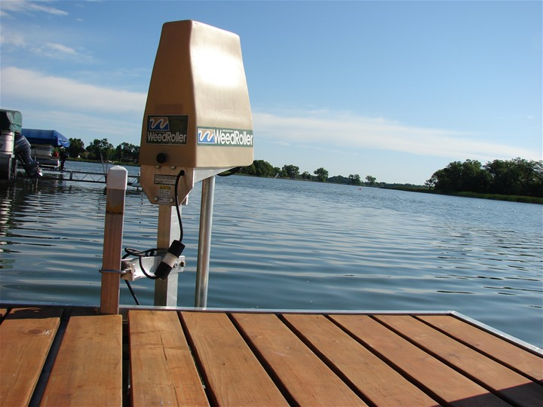
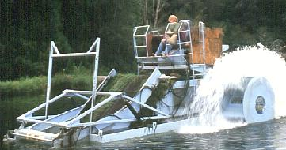
Mechanical Control Methods
Mowing
Use of backhoes/excavators
Raking
Mechanical Harvesters (aquatic invasives)

Slide 19
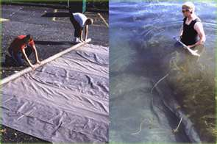
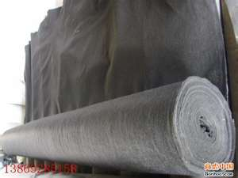
Barriers
Terrestrial weed barriers
Aquatic Benthic Barriers

Slide 20
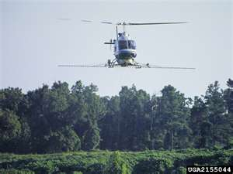
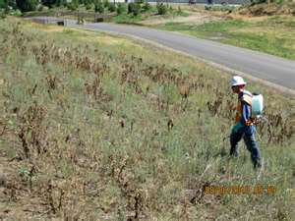
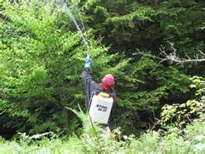
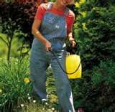
Chemicals

Slide 21
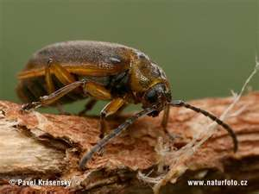
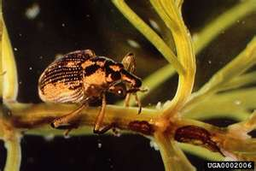
Biological
Galerucella calmariensis
Beetle used to control Purple Loosestrife.
Euhrychiopsis lecontei
Aquatic insect used to control Eurasian Water Milfoil

Slide 22
Please support your local PRISM !
For more information contact the SLELO-PRISM office at
(315) 387-3600
&
Visit our website at www.sleloinvasives.org
Thank You!

