Slide 1

Welcome
St. Lawrence, Eastern Lake Ontario
Partnership for Regional Invasive Species Management
SLELO-PRISM

Slide 2
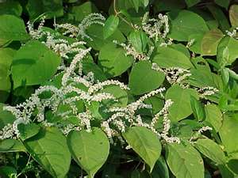
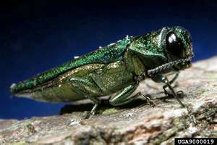
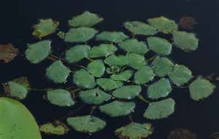
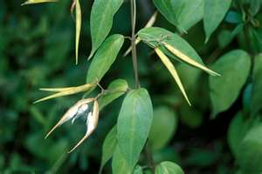
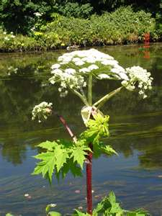
Proposed Framework
For
SLELO-PRISM
This presentation has been developed as a “proposed framework – guidance presentation” only - to help facilitate the establishment and working arrangements between the partners of the SLELO – PRISM.
Final working documents are intended to be developed as a group effort with partner input and involvement.

Slide 3
Some Basics
Organize Our PRISM
Determine goals, objectives, priorities (VISION)
Develop 5-year Strategic Plan
Identify Annual Work Initiatives
Begin Implementing Initiatives
Measure results
SLELO
PRISM

Slide 4
Proposed Organizational Process
(some of the following are based on actual contract deliverables*)
(Some specifics are based on other PRISM’ examples)
Conduct business based on Operational Guidelines*
Work together under a “Statement of Cooperation-SOC ”, a MOU, or a Cooperative Agreement *
Conduct business by an Executive/Steering Committee (principal partners)
Advised by and advisory committee (at-large partners ) – subcommittees.
Assisted by working groups (cooperating affiliates)
Make decisions by consensus (reflected in Op.Guidelines)
Hold regular meetings and additional meetings as needed
*Develop (5-year) strategic plan*
Prepare annual action plans*
There are 8-original partners listed on the “original documents, but there are 10-signature pages. None of the documents state who is principal and who is cooperating, etc.
There is a need to structure this better…

Slide 5
Basic Goals & Objectives ( just to get us thinking ! )
( lets spell this out in a strategic plan !)
1. Prevent new invasions of invasive species.
Increase public awareness and involvement to prevent the spread of invasive species.
ED/RR
*Other objectives as identified
2. Identify AOC’s and eradicate/suppress new invasions.
Coordinate regional invasive plant inventory and monitoring program utilizing staff and volunteers.
*Other objectives as identified
3. Manage established infestations.
Facilitate the management, containment, and control of priority invasive plant infestations.
*Other objectives as identified
4. Develop long-term BMP’s to address I.Spp.
Identify and develop best management practices that will assist in managing the threat of invasive species for an indefinite period beyond the 5-year strategy period. Focus on areas and species where an expenditure of limited resources will have tangible, lasting, long-term conservation benefit.

Slide 6
Supporting “Process” Information:
Conduct business based on Operational Guidelines;
It is desirable to have a set of guidelines to follow when conducting business on behalf of the partnership. One possibility or “sample set” is shown in Attachment A.
Work together under a Memorandum of Understanding (Cooperative Agreement) OR a general “Statement of Cooperation”:
A cooperative agreement or SOC outlines the means by which partners of the SLELO-PRISM interact and conduct business of the PRISM. Other PRISMS have or are in the process of developing cooperative agreements between partners. Some are lengthy and detailed and others or short and condensed. Some Organizations cannot sign these! When developing such an agreement it is important to create an agreement that is functional and accepted by all partners. One possible scenario is provided as Attachment B.
Note: An old agreement exists for SLELO, but is quite outdated, should it be revised ? Should we go with a SOC ?

Slide 7
Conduct business by a executive/steering committee (principal partners):
For the purpose of efficient and effective process, other PRISMs have developed a core committee consisting of principle partners. Should the SLELO PRISM choose this path, the executive/steering committee might consist of those entities shown in Attachment C.
Advised by an advisory committee (at-large partners):
Recognizing that the SLELO region encompasses five (5) counties, the executive committee could seek advice and input from an “at-large” component consisting of a representative from each county (perhaps serving based on theme, e/g/ aquatics, terrestrial, insect). Possible candidates are shown in
Attachment C.
Assisted by working groups (cooperating affiliates):
To increase the capacity of the SLELO-PRISM, interested organizations and individuals are encouraged to participate on various undertakings within a workgroup or “subcommittee” context. Identified cooperating affiliates are presented in Attachment C.
Combined, all levels make up the SLELO Partnership.

Slide 8
Make decisions by consensus:
The steering/executive committee, the advisory committee and cooperating affiliates would all function based on consensus.
Hold regular meetings
And additional meetings as needed:
Develop (5-year) strategic plan:
This component is perhaps one of the most important endeavors to be considered by the SLELO-PRISM. Determining goals and objectives and developing a comprehensive strategy to meet the needs of the PRISM can play an integral role in how the PRISM manages invasive species. It is important to ensure that the strategic plan is comprehensive and that all partners provide input to the strategy.
*Engaging a professional “facilitator” to guide the partners through the process will ensure a comprehensive outcome.
*Follow DEC Template:
*Think long term benefits v.s. short term projects..

Slide 9
Prepare annual work plans:
Once the SLELO partners have adopted a “Strategic Plan” it will become important to develop annual work/action plans. The partners will work together to identify AOC’s and to prioritize and select tasks to be completed on an annual basis.
Year 1 | Tasks – deliverables
Year 2 | Tasks – deliverables
Year 3 | Tasks - deliverables
Year 4 | Tasks - deliverables
Year 5 | Tasks - deliverables
Completing identified tasks will help us to measure/quantify our success.
Any monetary requirements to assist with the implementation of annual work plans and projects identified by the partners, should be considered on a case-by-case scenario with an application / approval process by the executive committee. This will help us to maximize our efforts, identify volunteer v.s. paid seasonal employee elements and leverage additional project funding & resources. The host organization may require a separate agreement with the contracting entity.

Slide 10
Attachment C.
Principal Partners (executive/steering committee)
NYS Dept. of Transportation
NYS DEC
The Nature Conservancy
Cornell Coop. Extension
NYS Parks & Historic Preservation
NYS Sea Grant
USDA
At-Large Partners (advisory committee)
St. Lawrence County Representative
Jefferson County Representative
Lewis County Representative
Oneida County Representative
Oswego County Representative
Cooperating Affiliates:
Ducks Unlimited
Tug Hill Tomorrow Land Trust
Tug Hill Commission
Fort Drum Military Installation
Lake Bonaparte Conservation Club
Cooperating affiliates shall be open to all who demonstrate an active interest and who support our mission.

Slide 11
General Consensus on Framework
Comments & Suggestions
Need to Develop Operational Guidelines
Should we use the sample provided as a template or re-invent the wheel ?
Adopt
Strategic Plan Development
Hire Professional Facilitator (perhaps with Invasive Species Background)
Start work on a Strategic Plan (with partner input and involvement)
Adoption
Revise
Eventually Develop Annual Work Plans ( year 1 – 5 )
Update/Revise Partner Agreement or use a Statement of Cooperation
Will blossom from the Strategy
Review period
Revisions
Adoption
Would be nice to have this by early spring………..
Should include: Projects, activities, tasks, efforts & logistics.
Review
Revisions and/or move forward.
Does this sound like a good approach ?
Begin developing plan this fall.
N
E
X
T
S
T
E
P
S

Slide 12
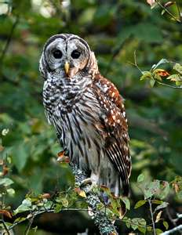
Discussion…….
A large woodland owl, the Barred Owl (Strix varia) is familiar for its distinctive "who-cooks-for-you, who-cooks-for-you-all" hooting and can be easily called-in using a common hand-held Barred Owl call.

